Slide 1
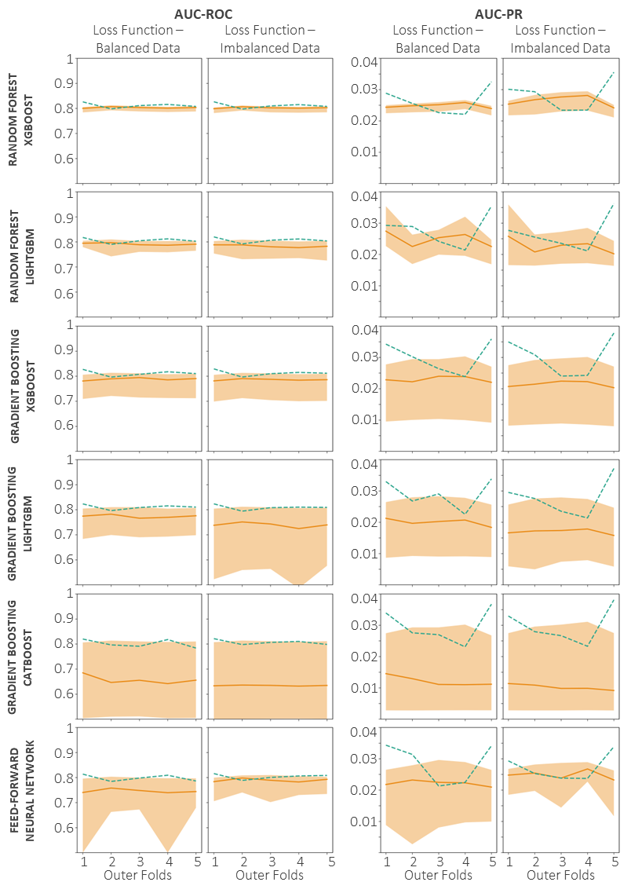
Optuna Hyperparameter tuning and model generalisation
Evaluation metrics over inner validation and outer fold test datasets

Slide 2
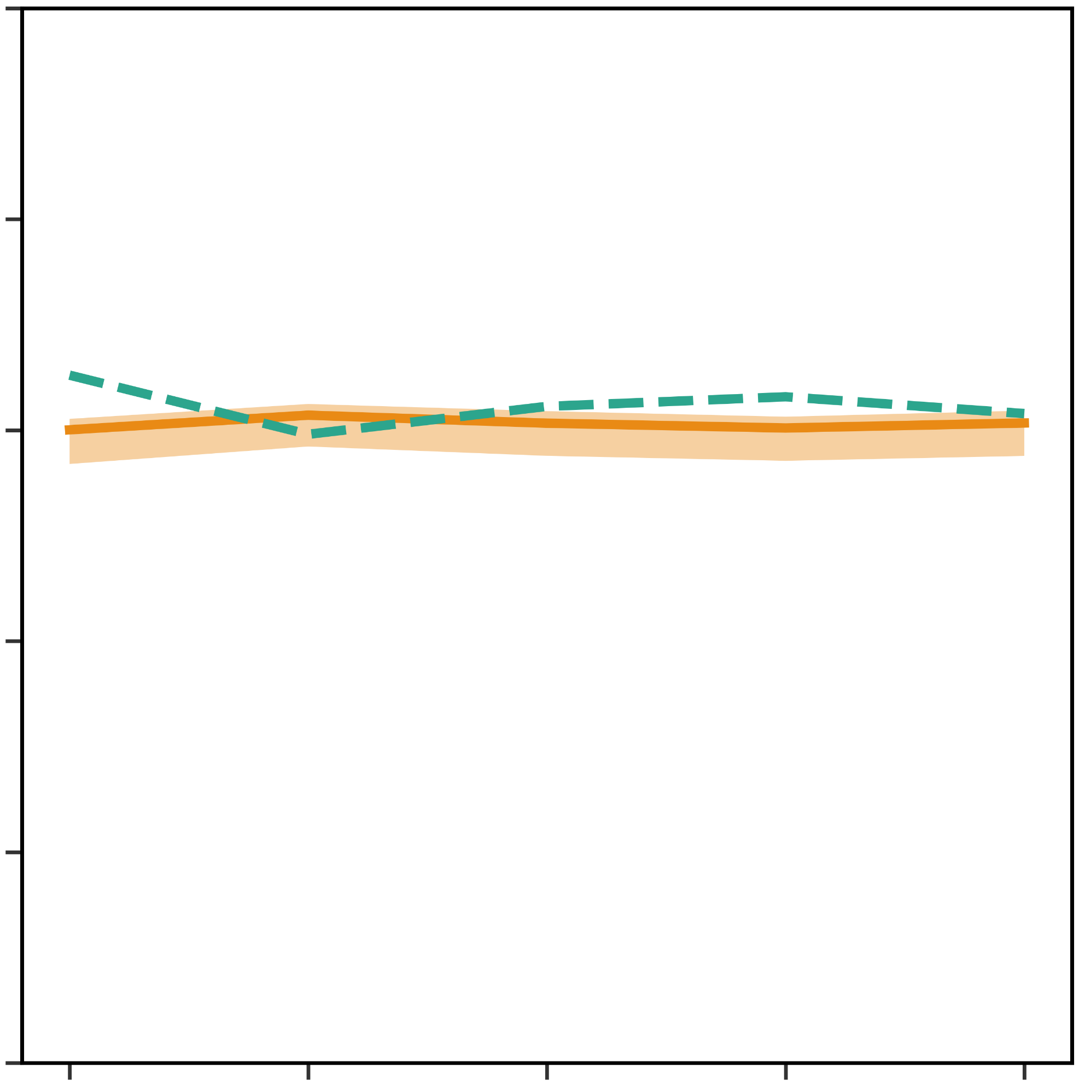
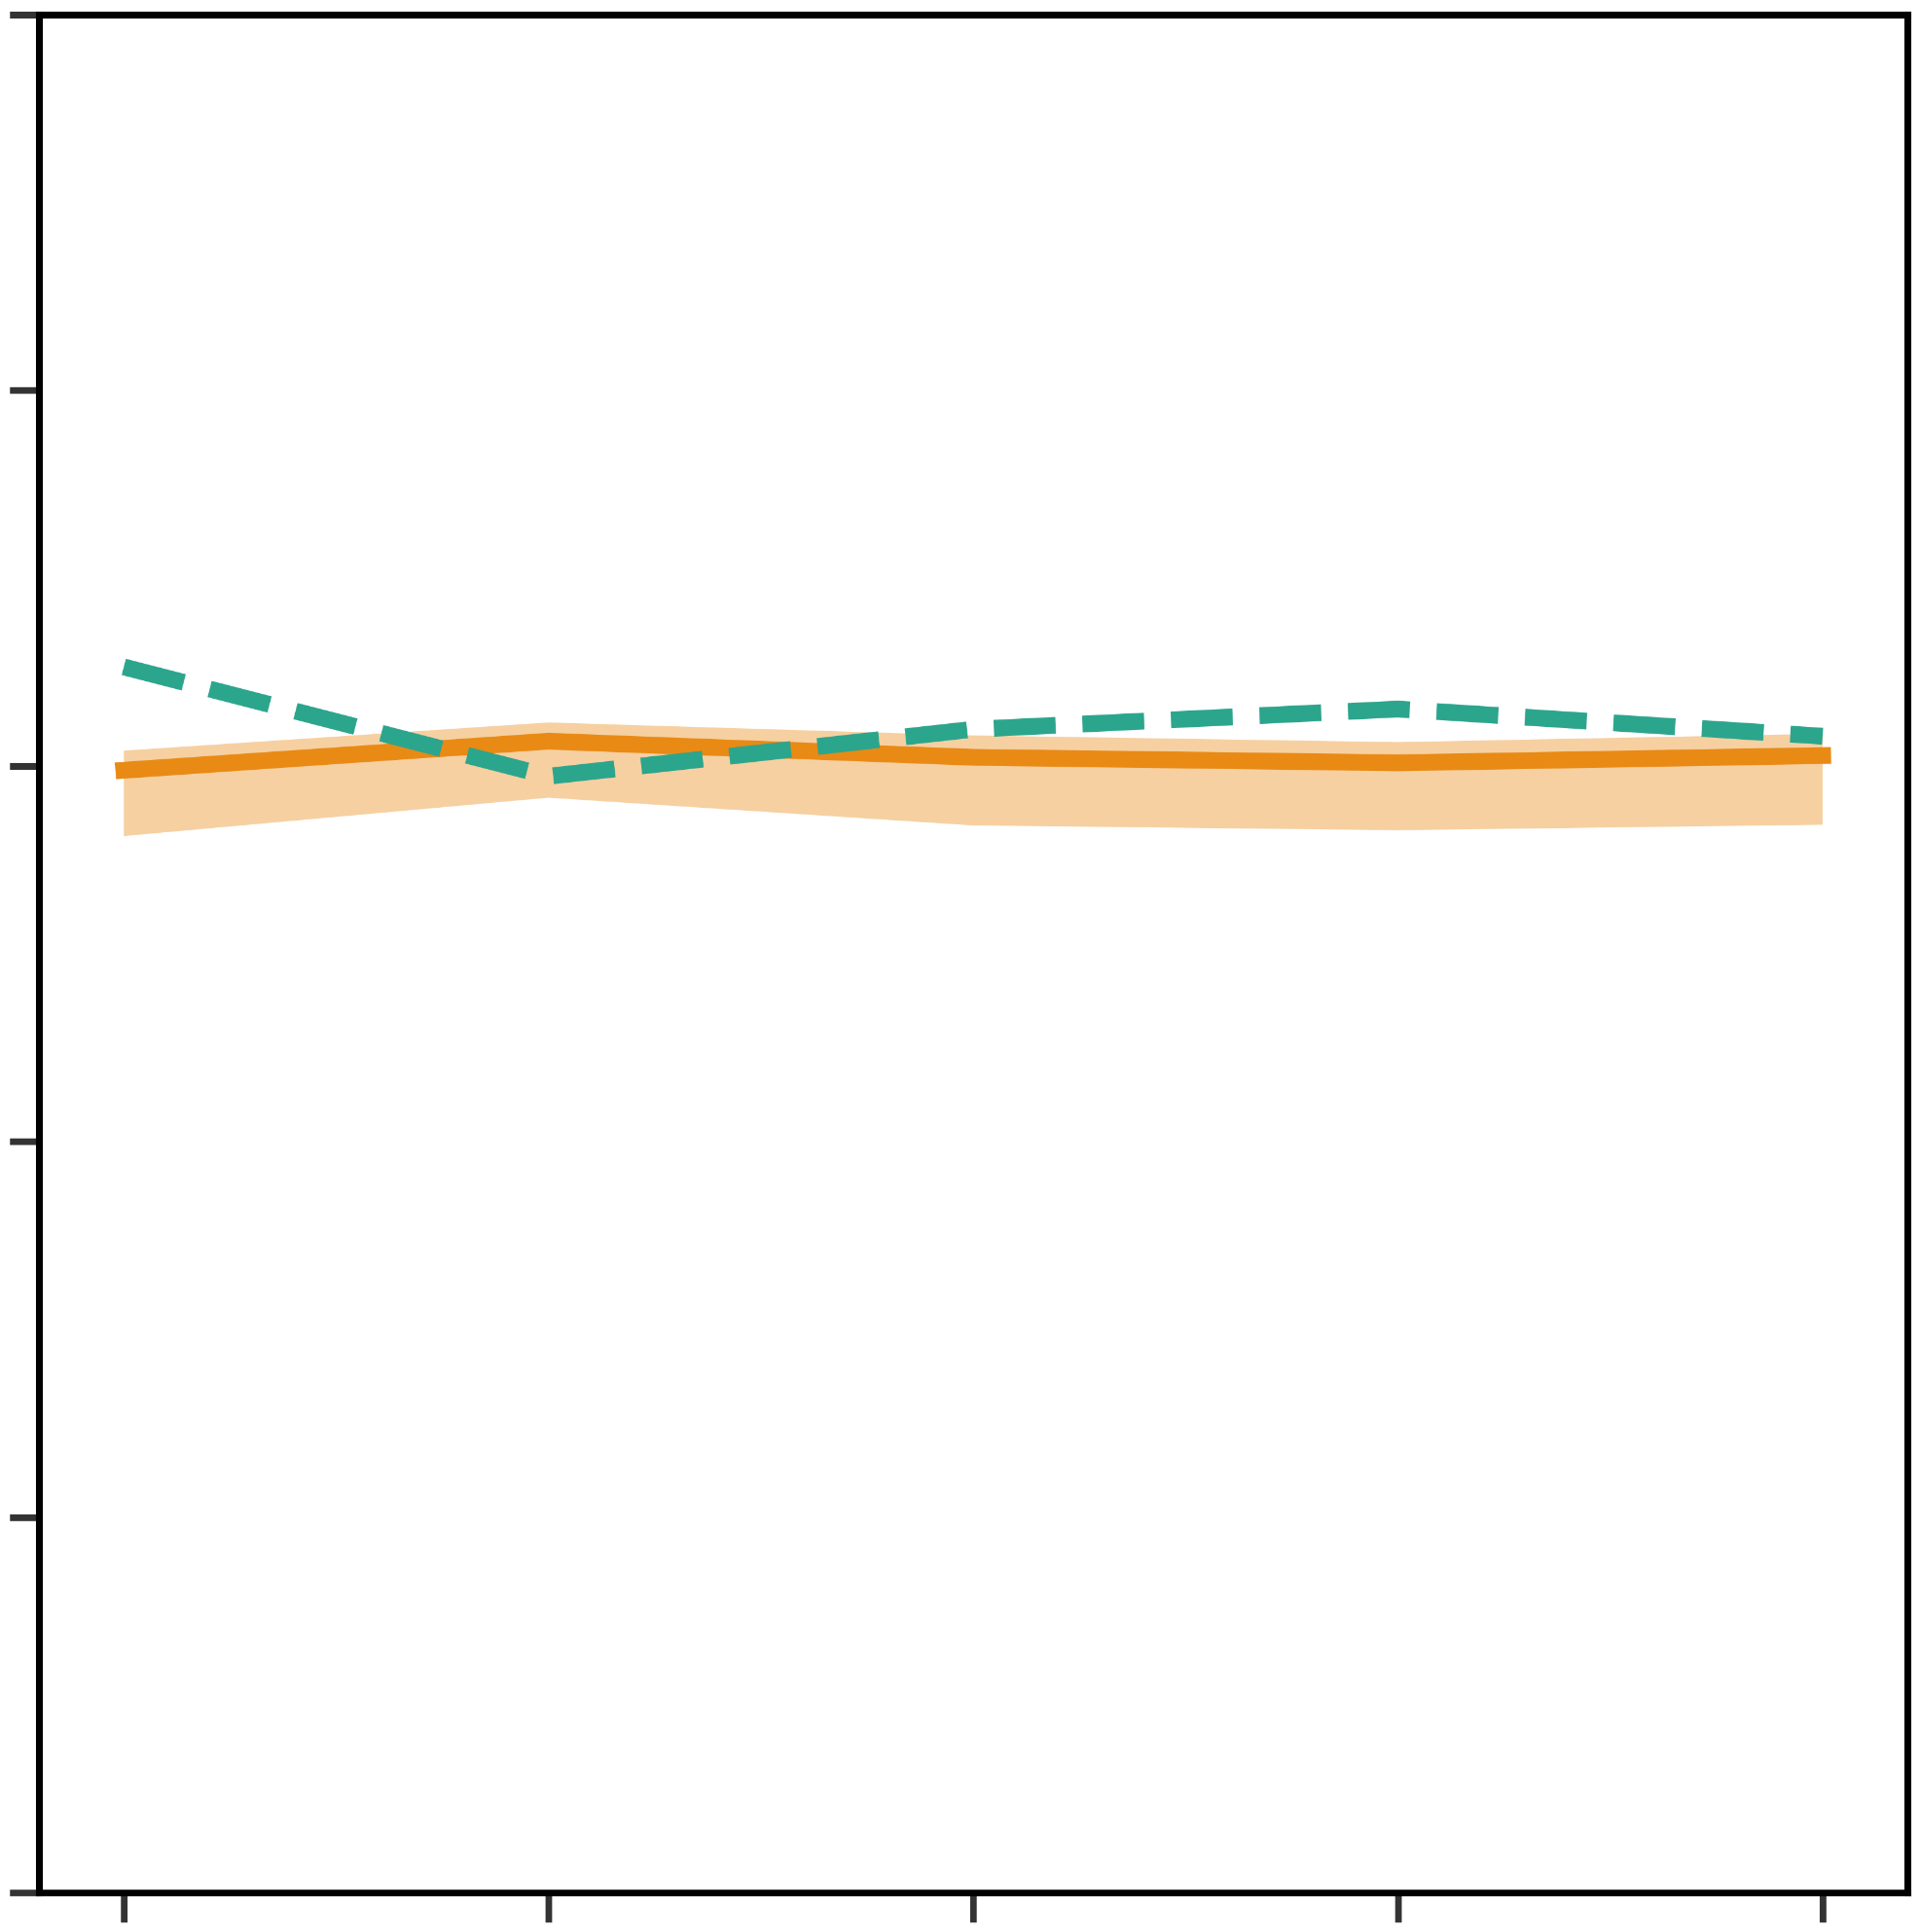
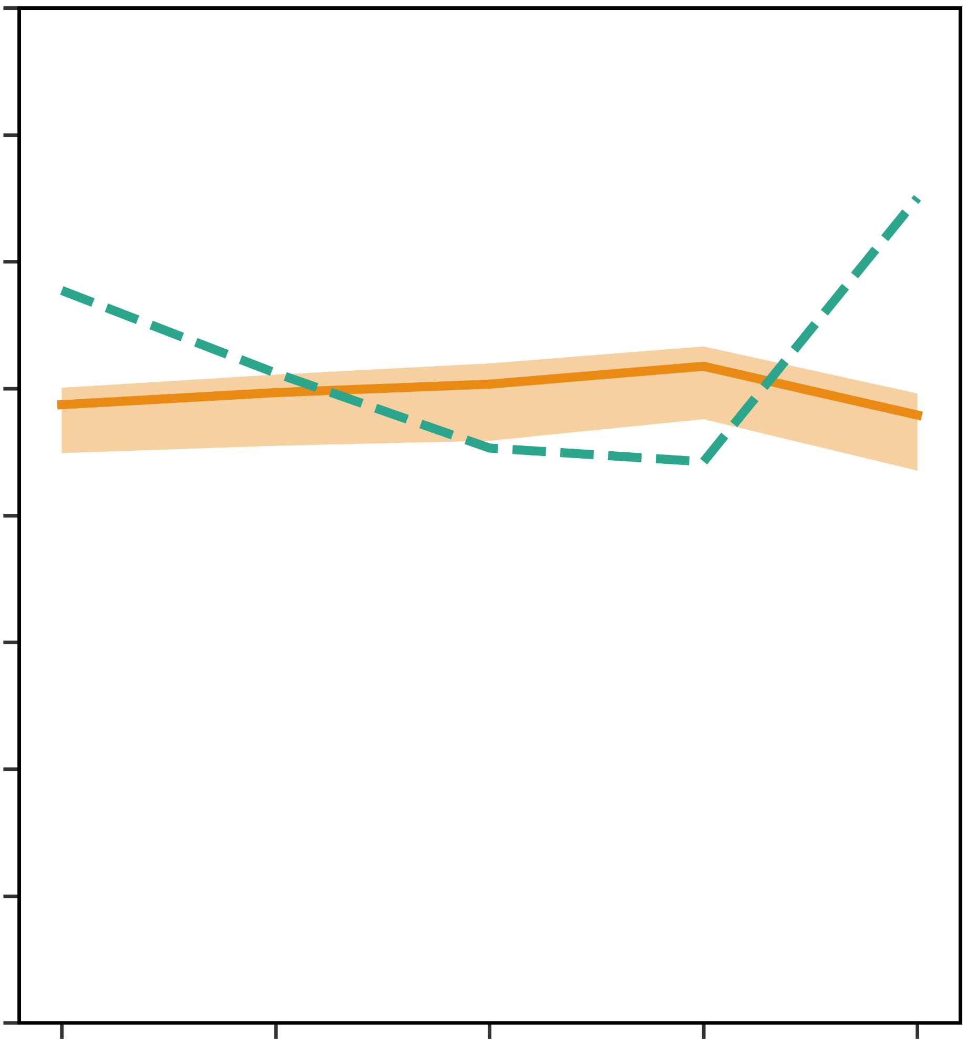
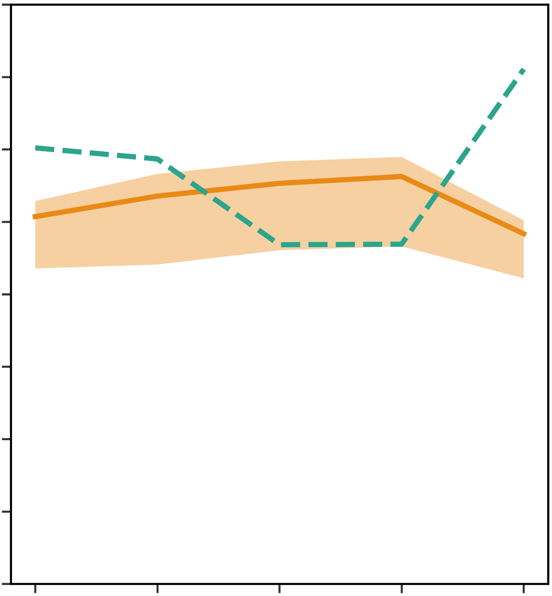
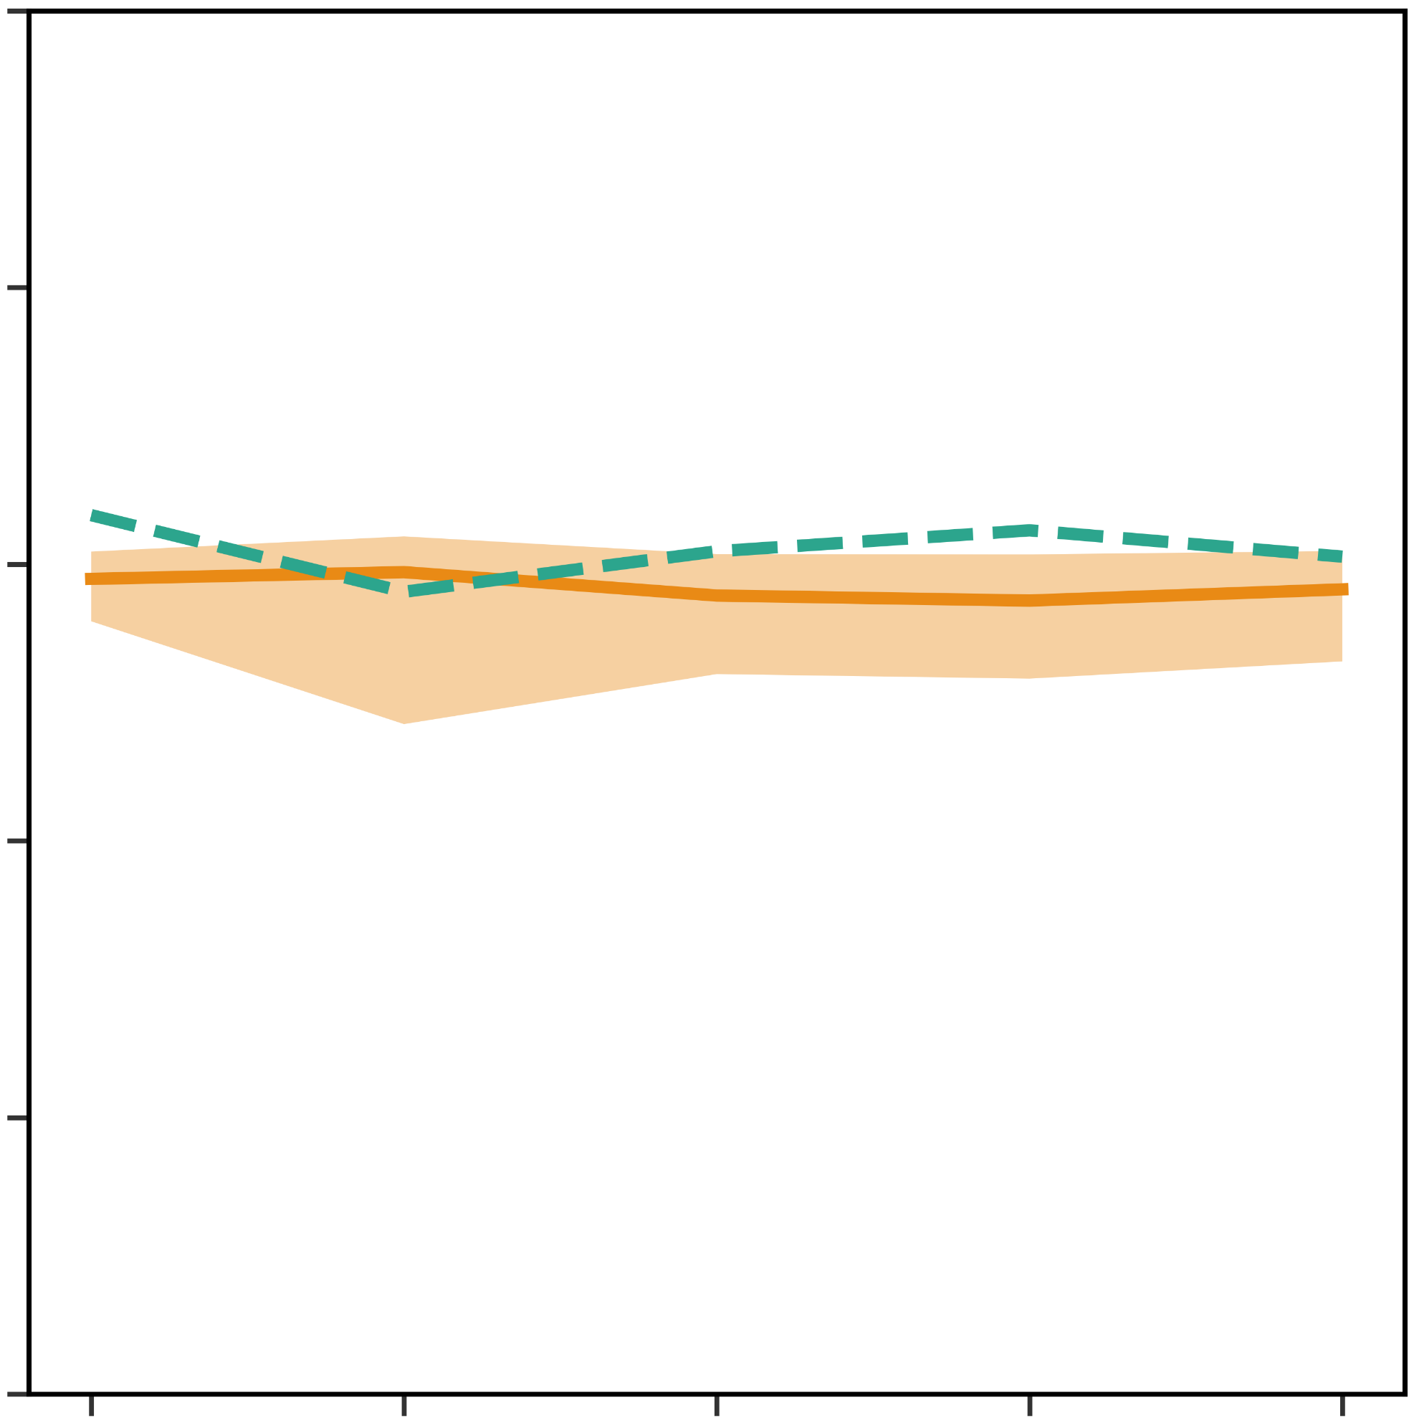
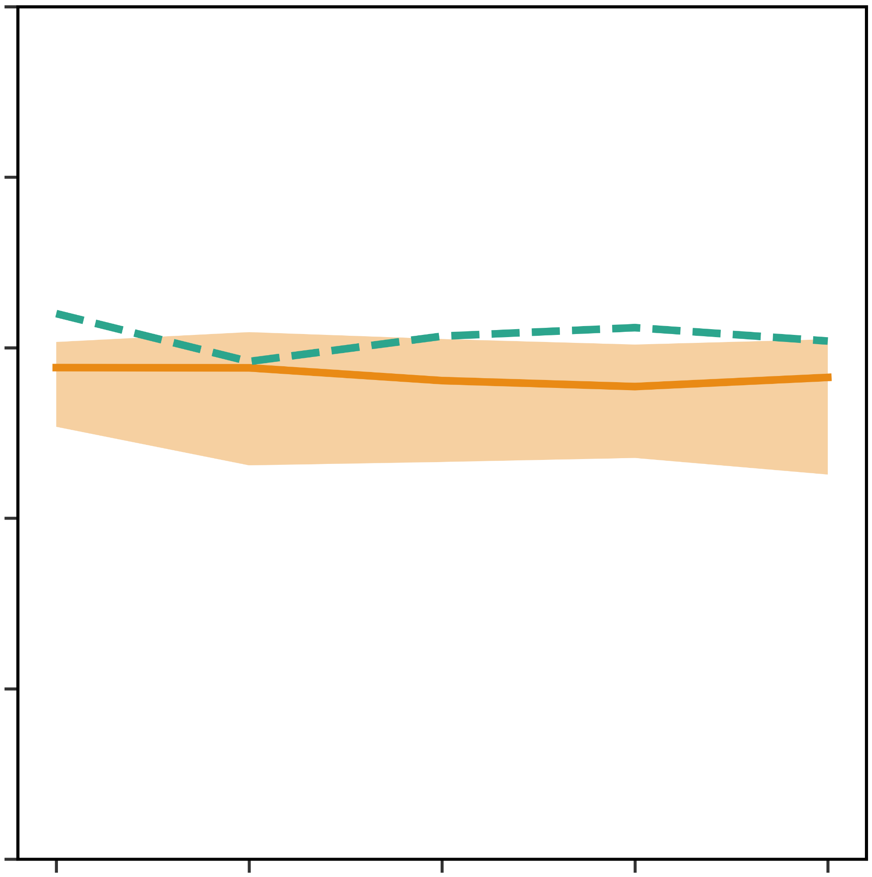
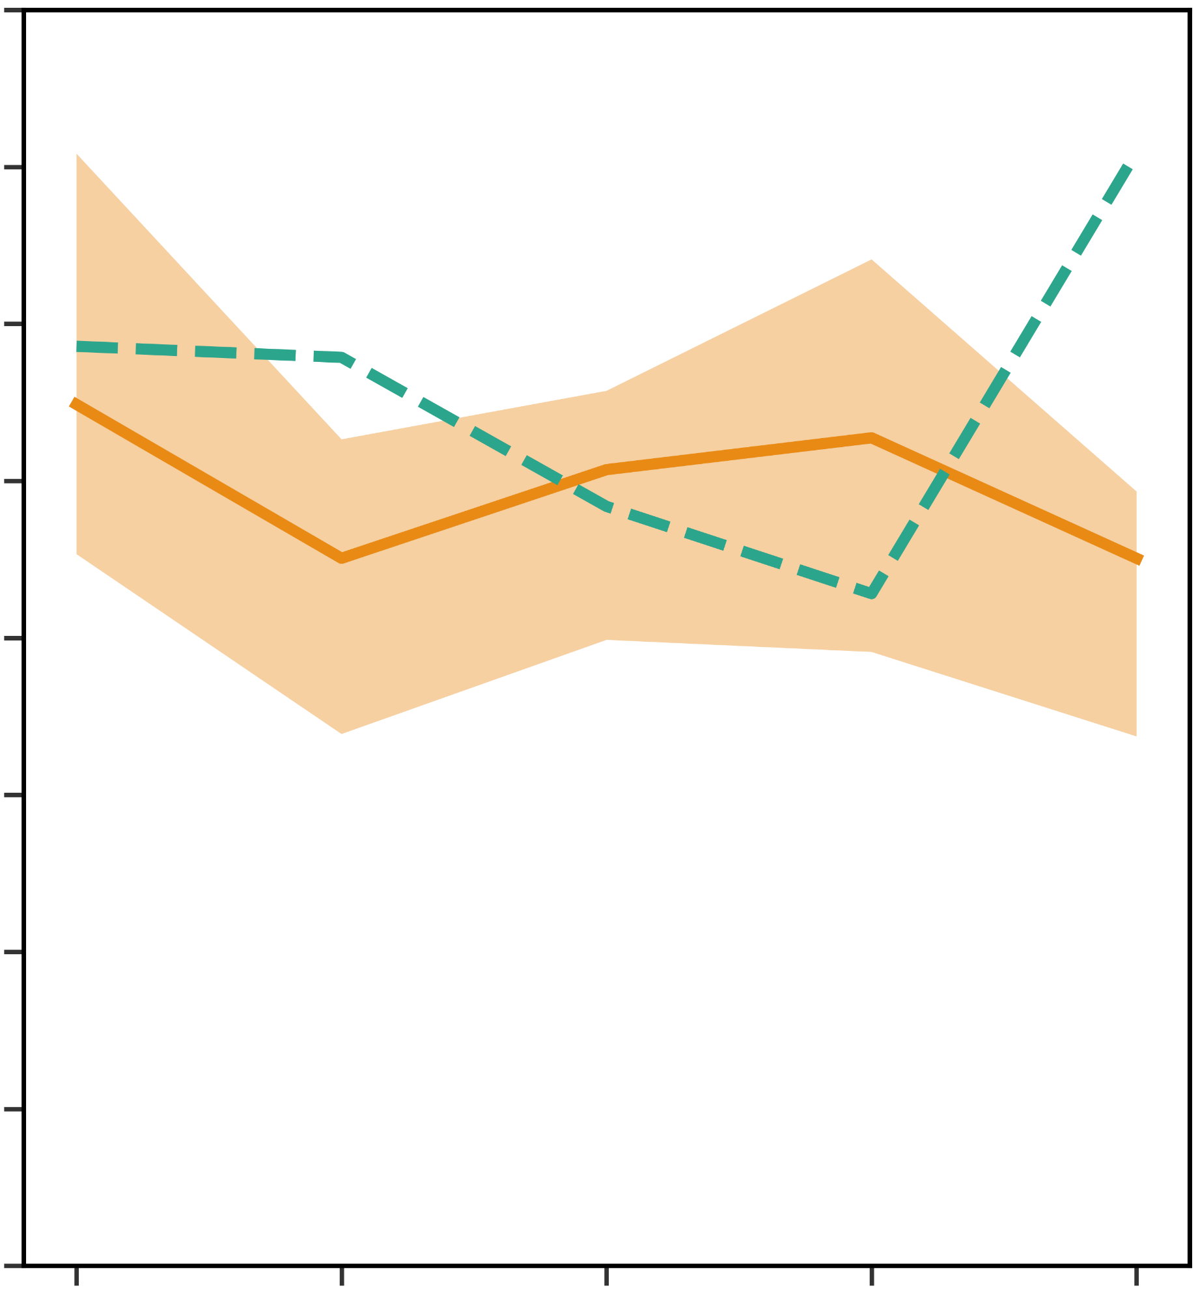
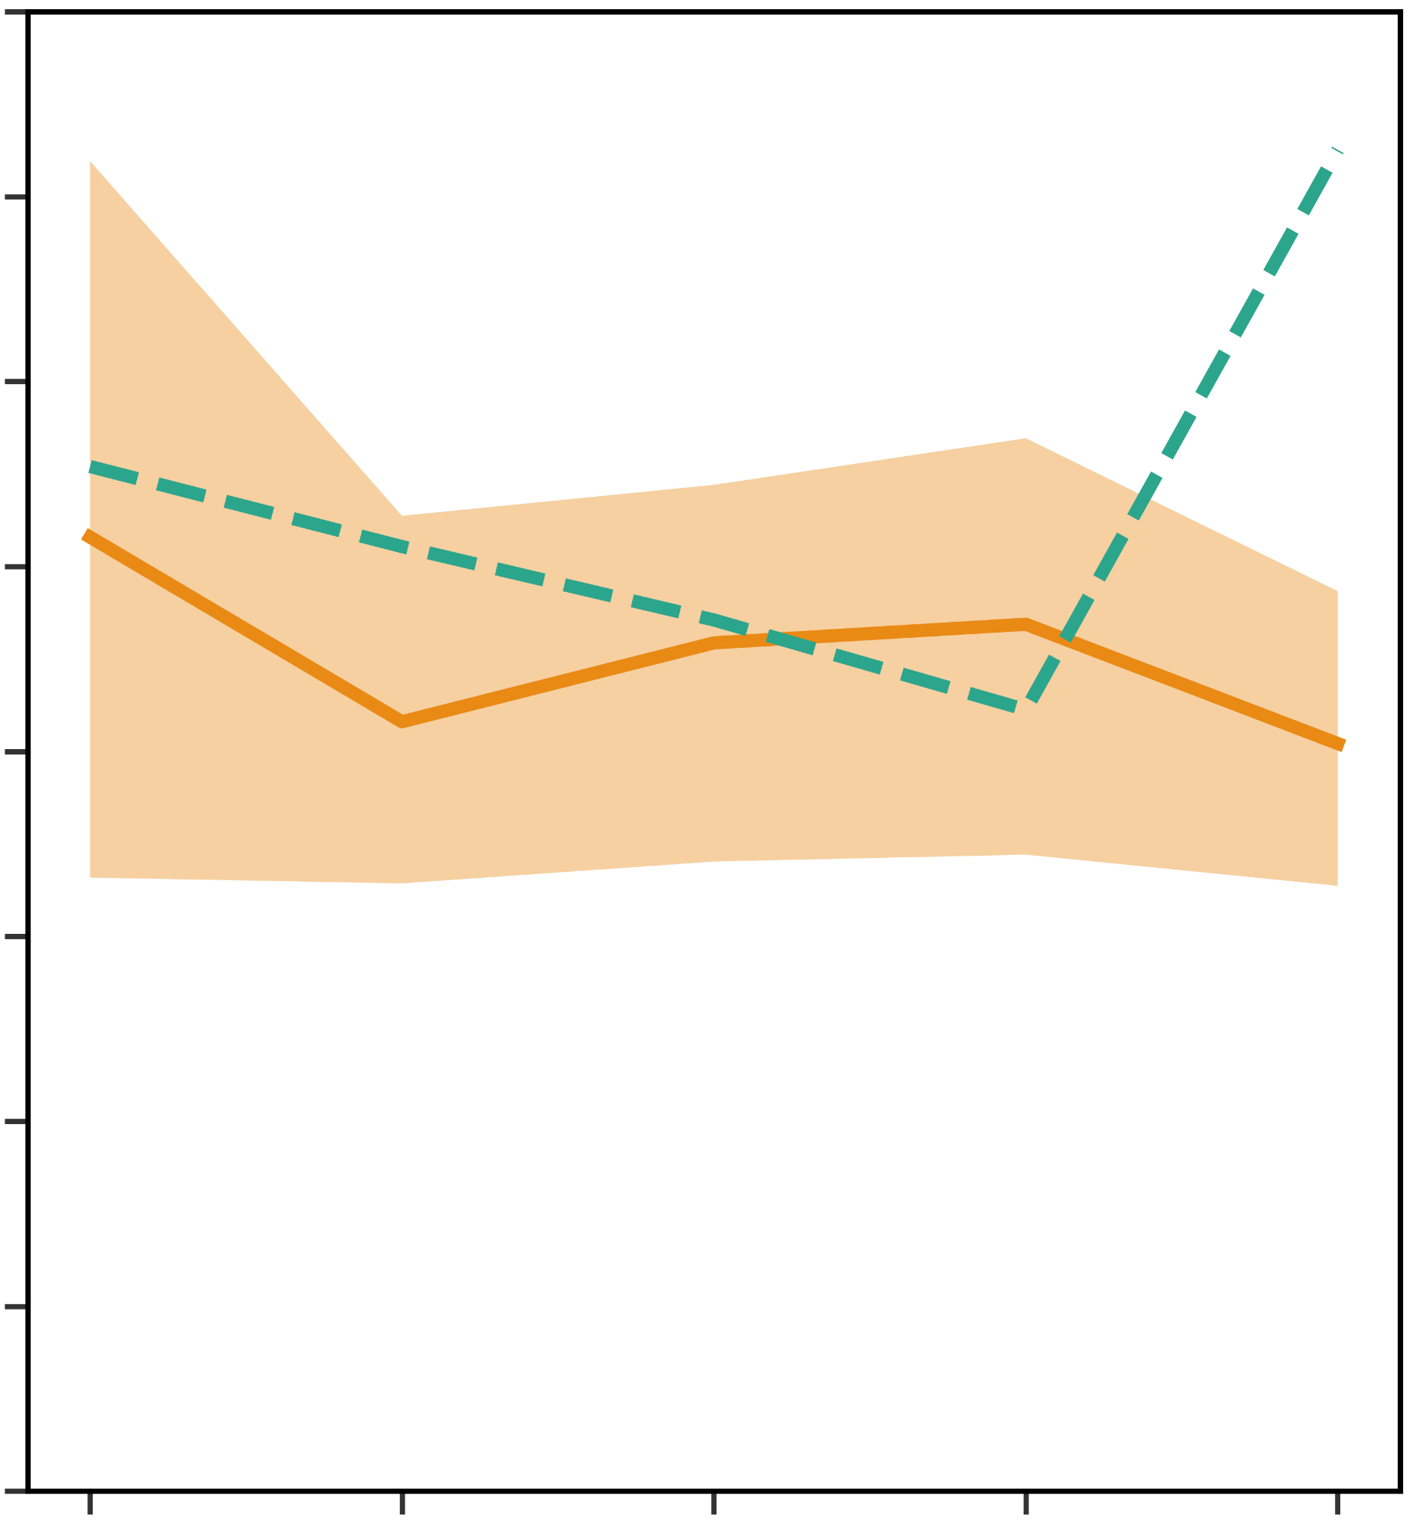
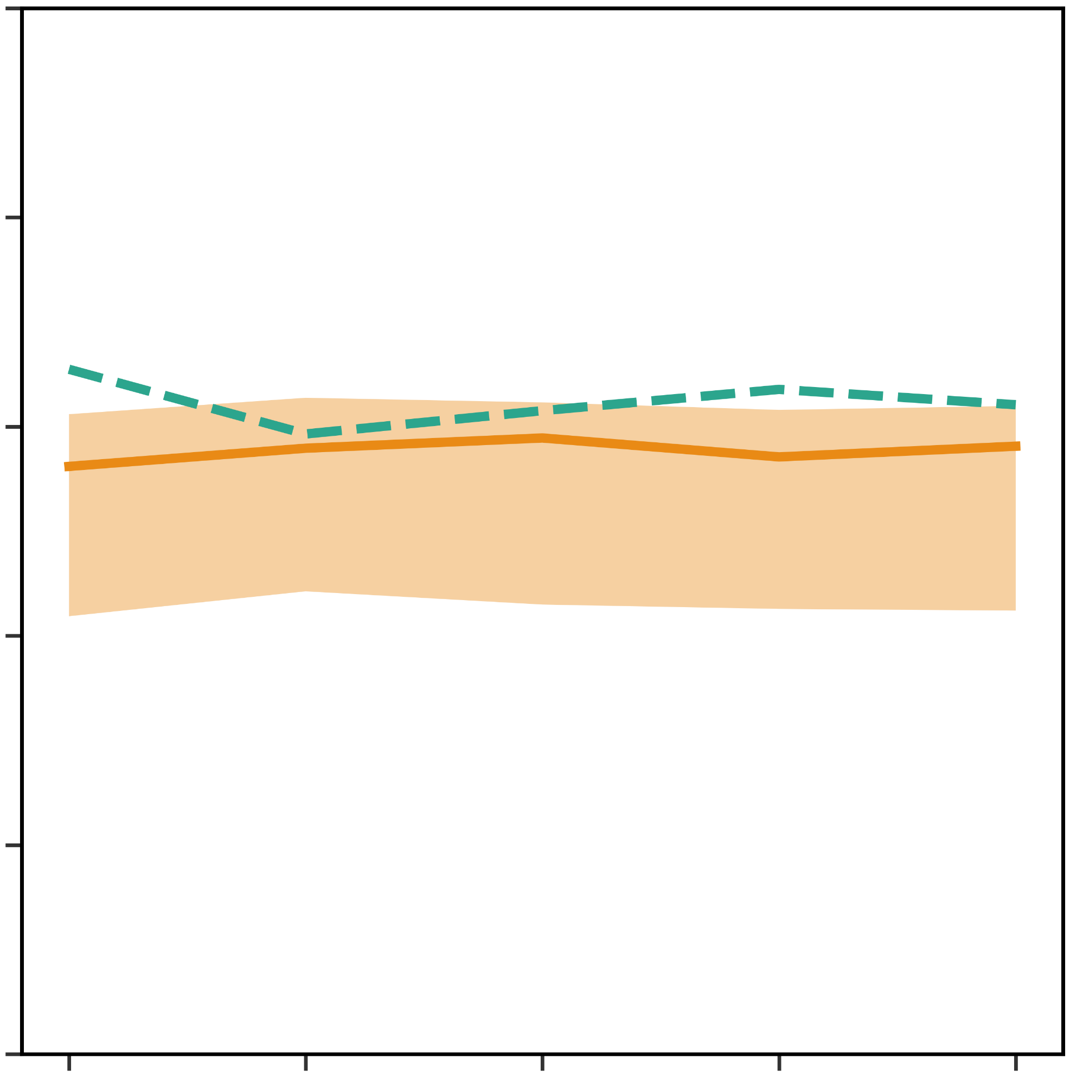

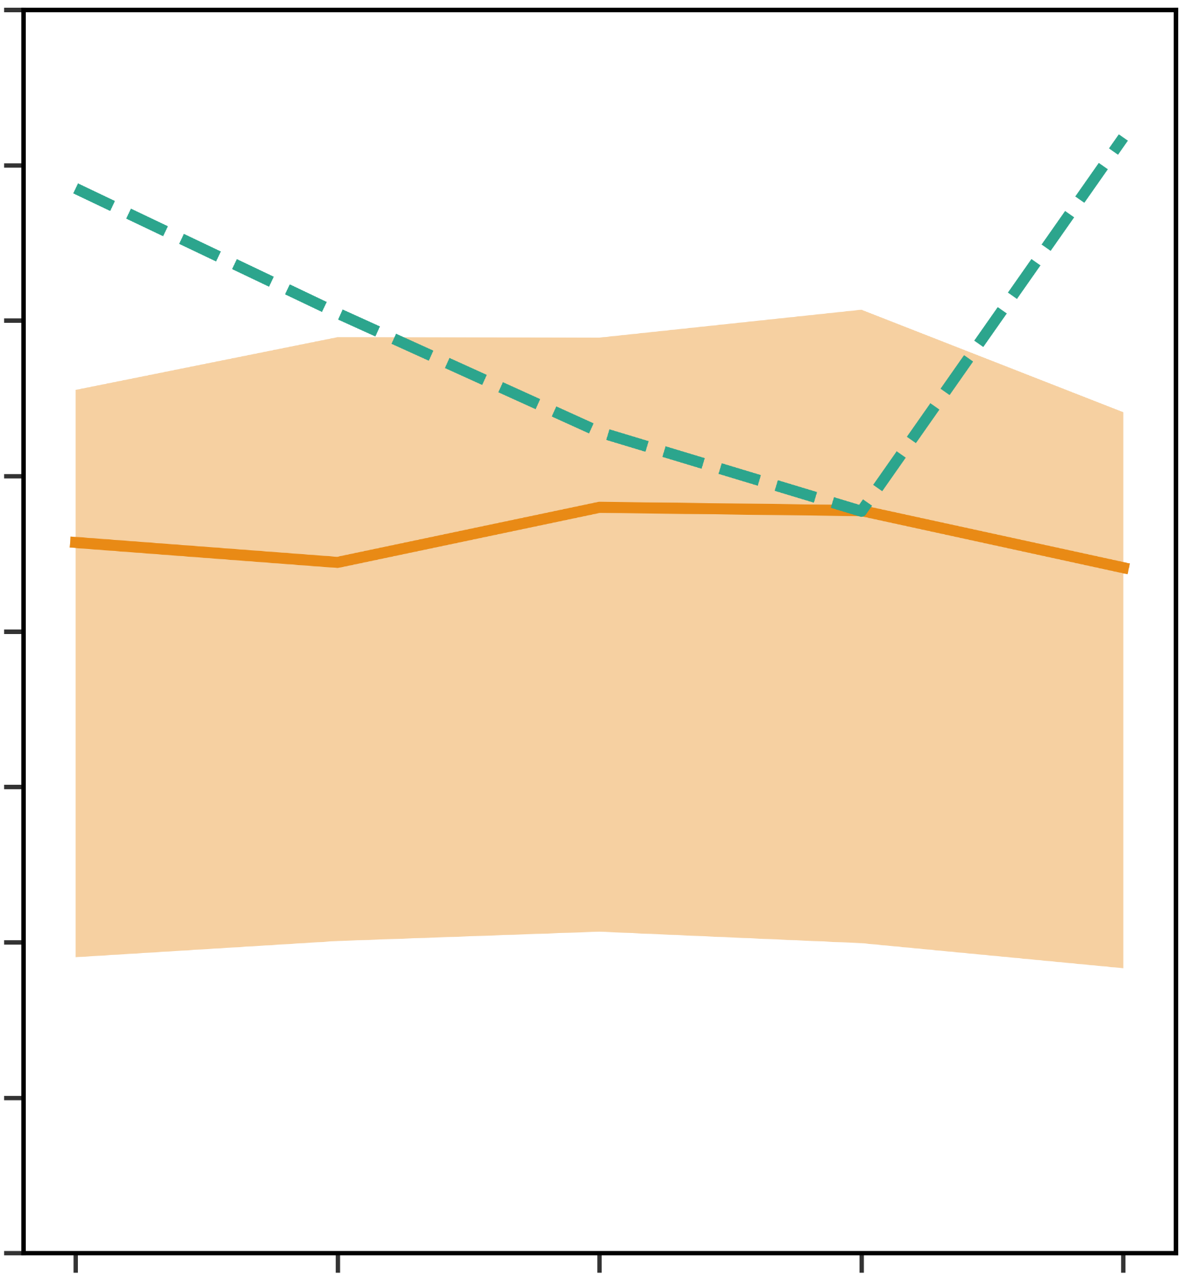
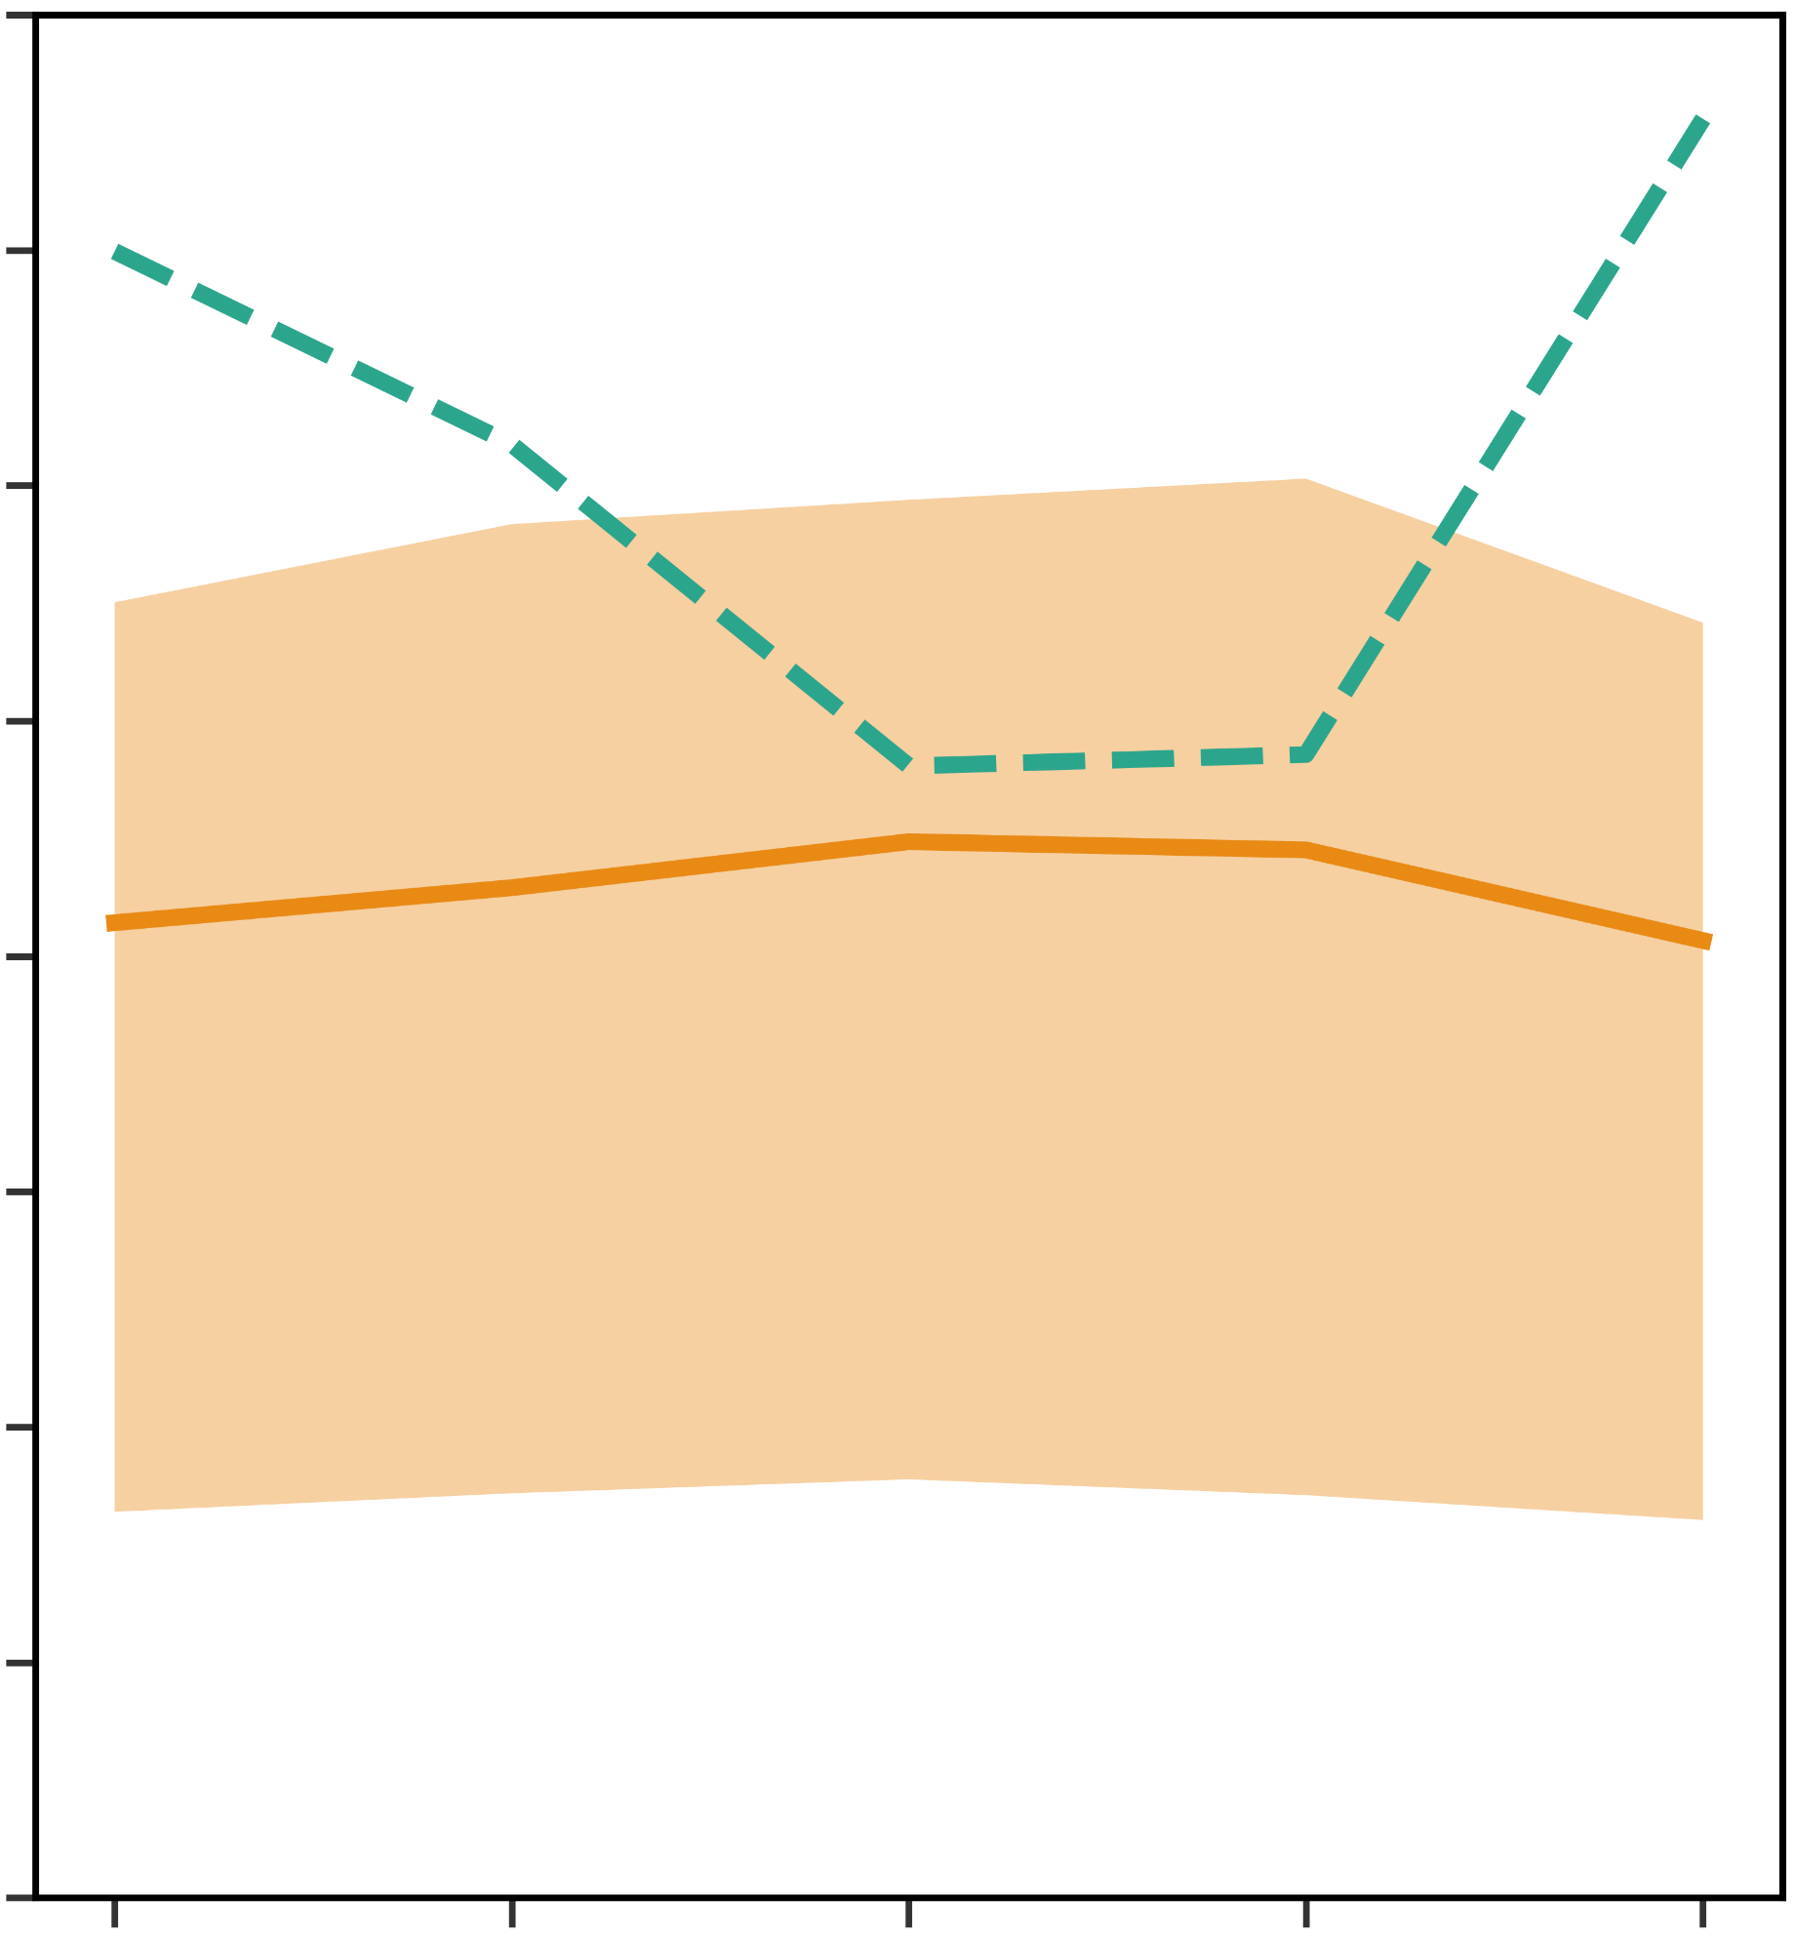
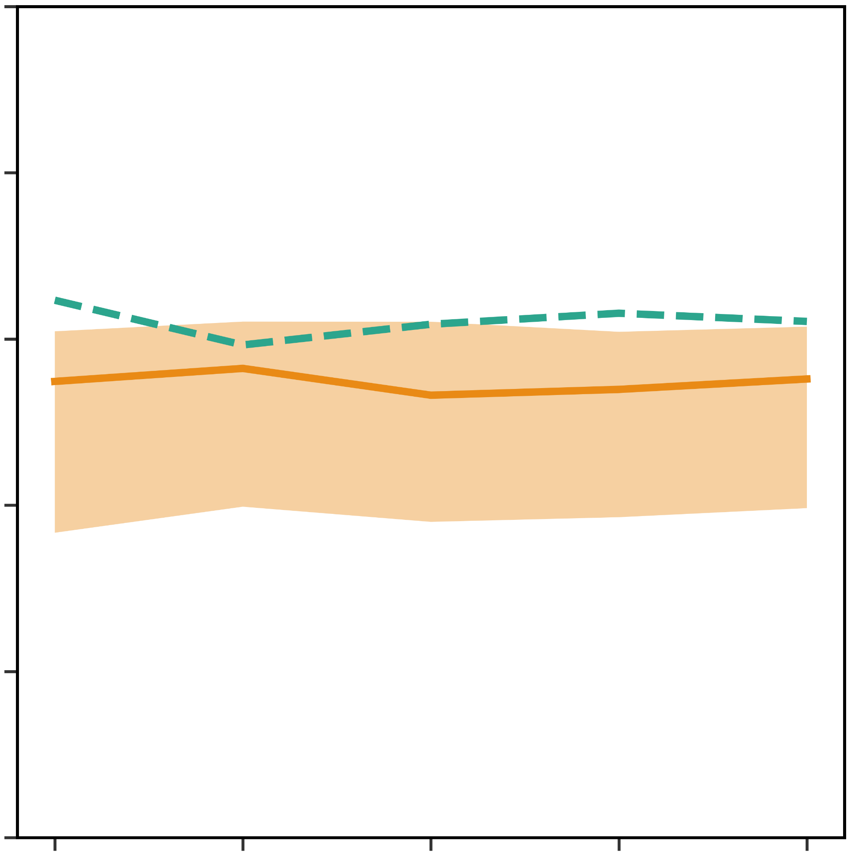
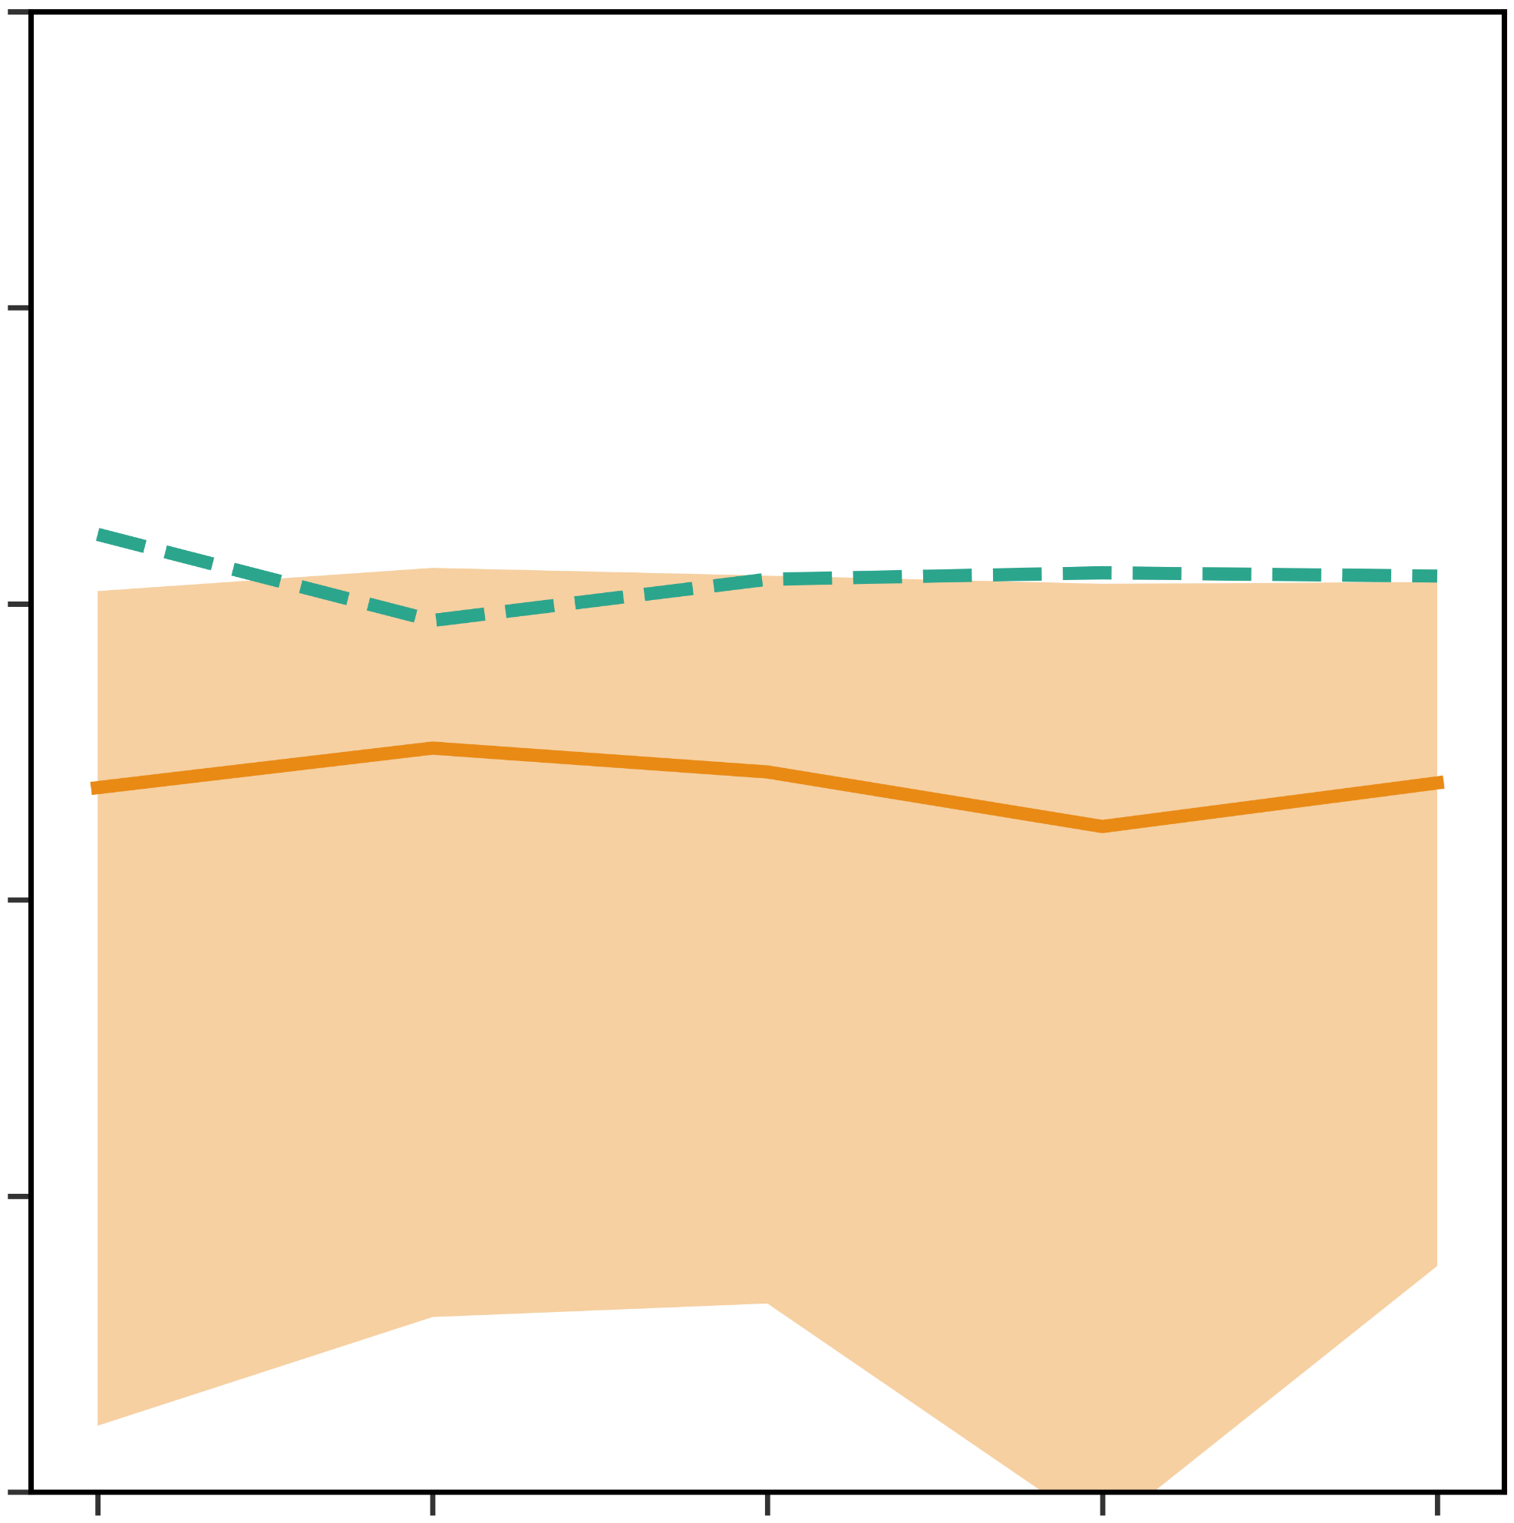
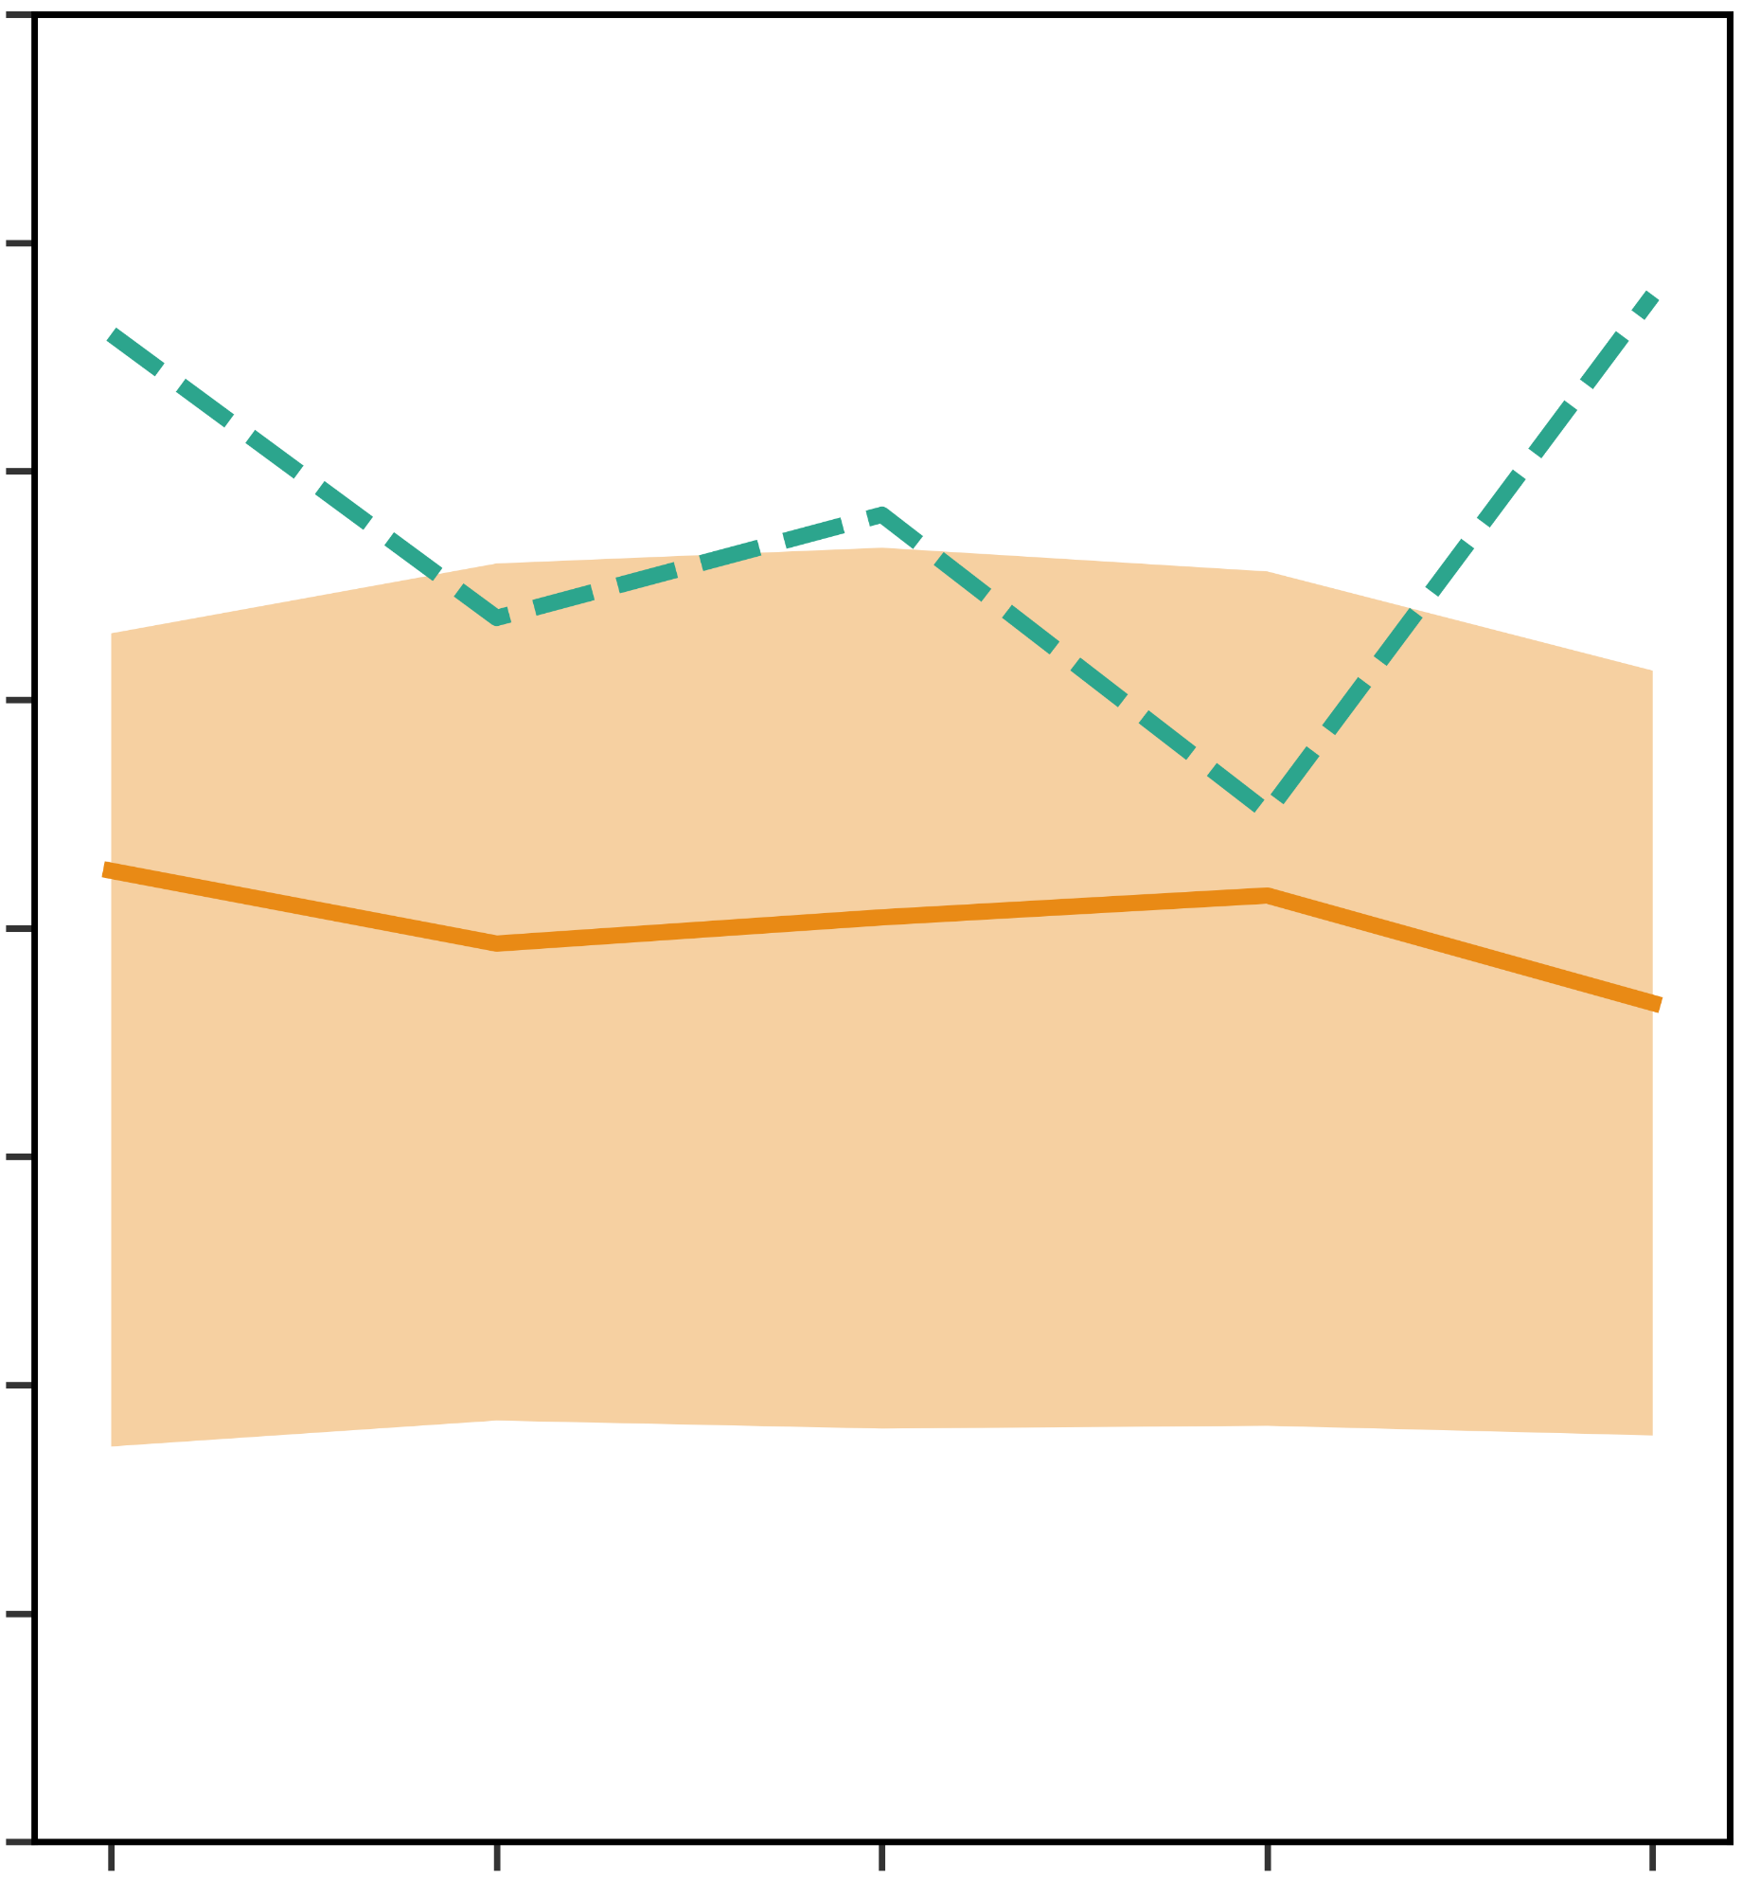
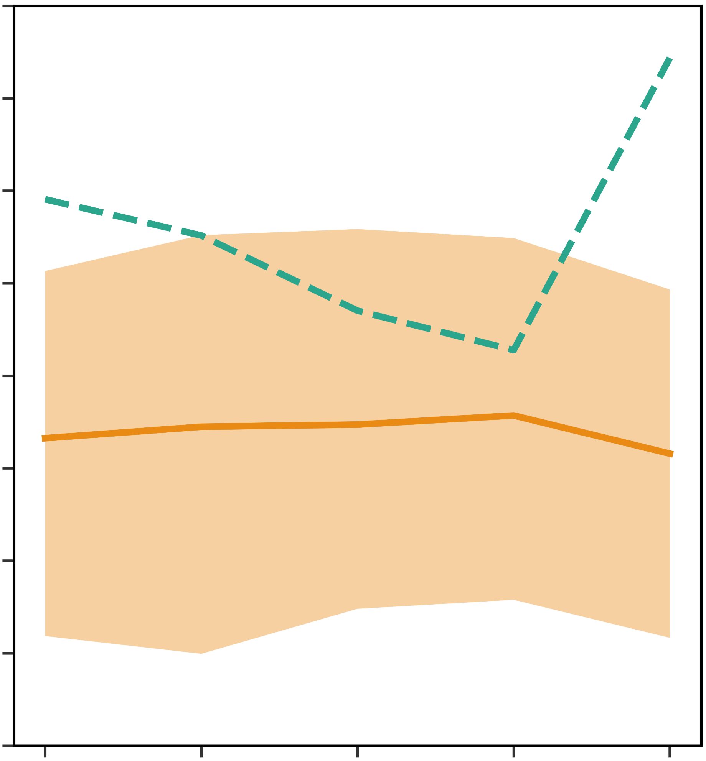
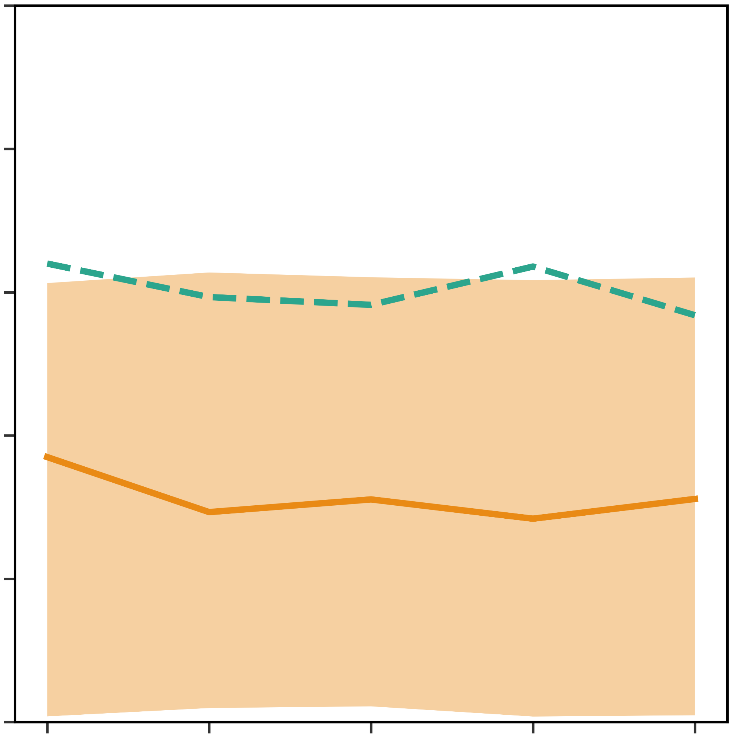
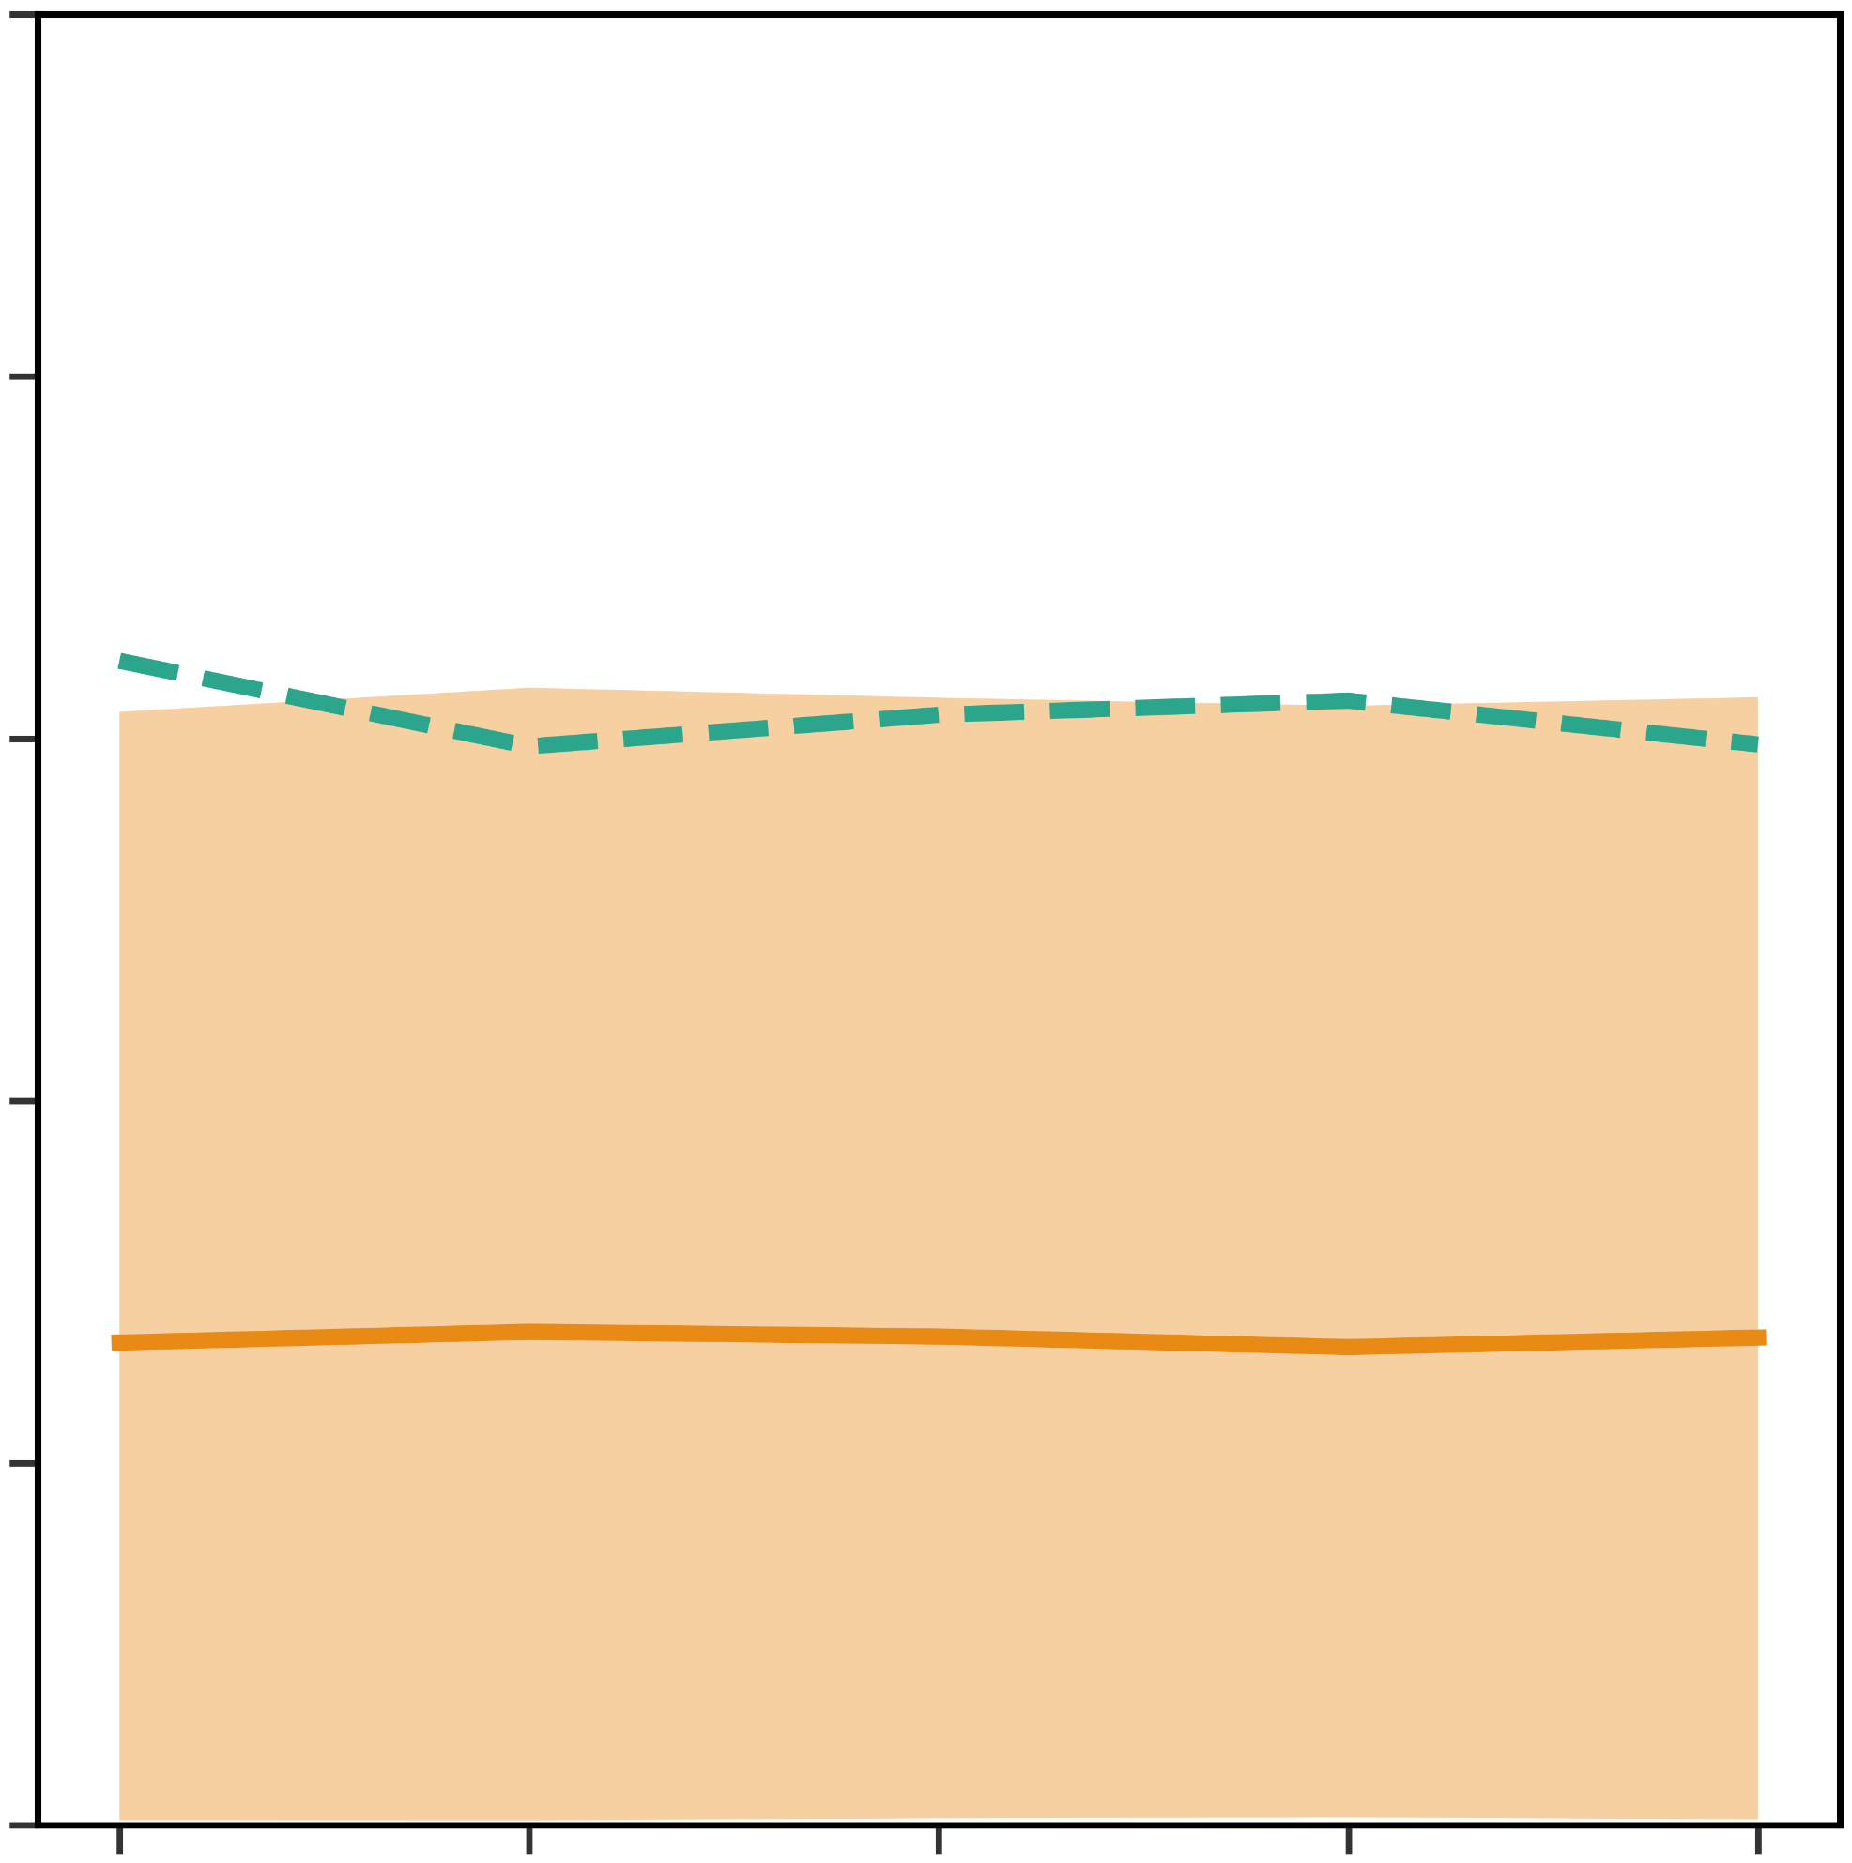
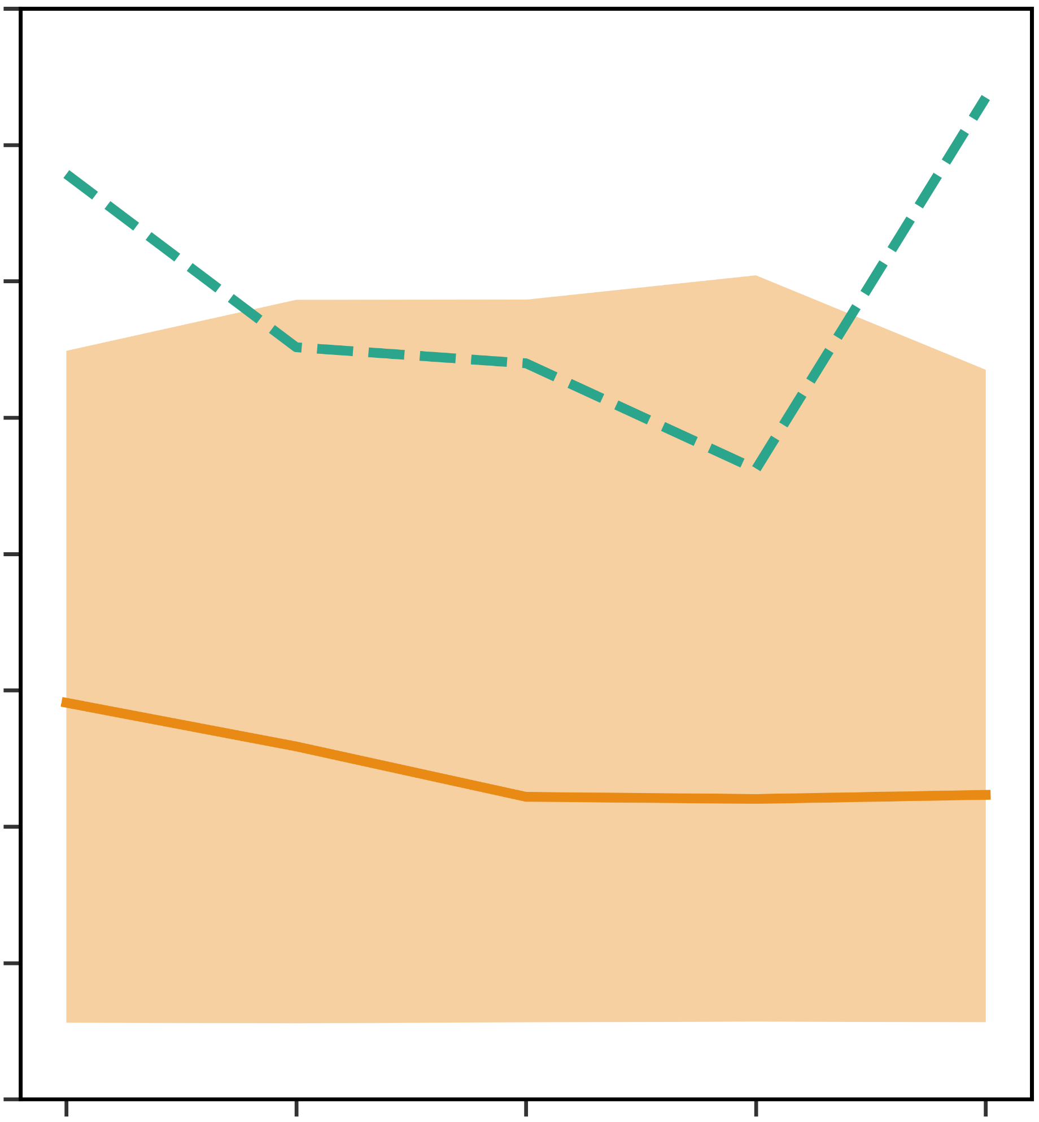
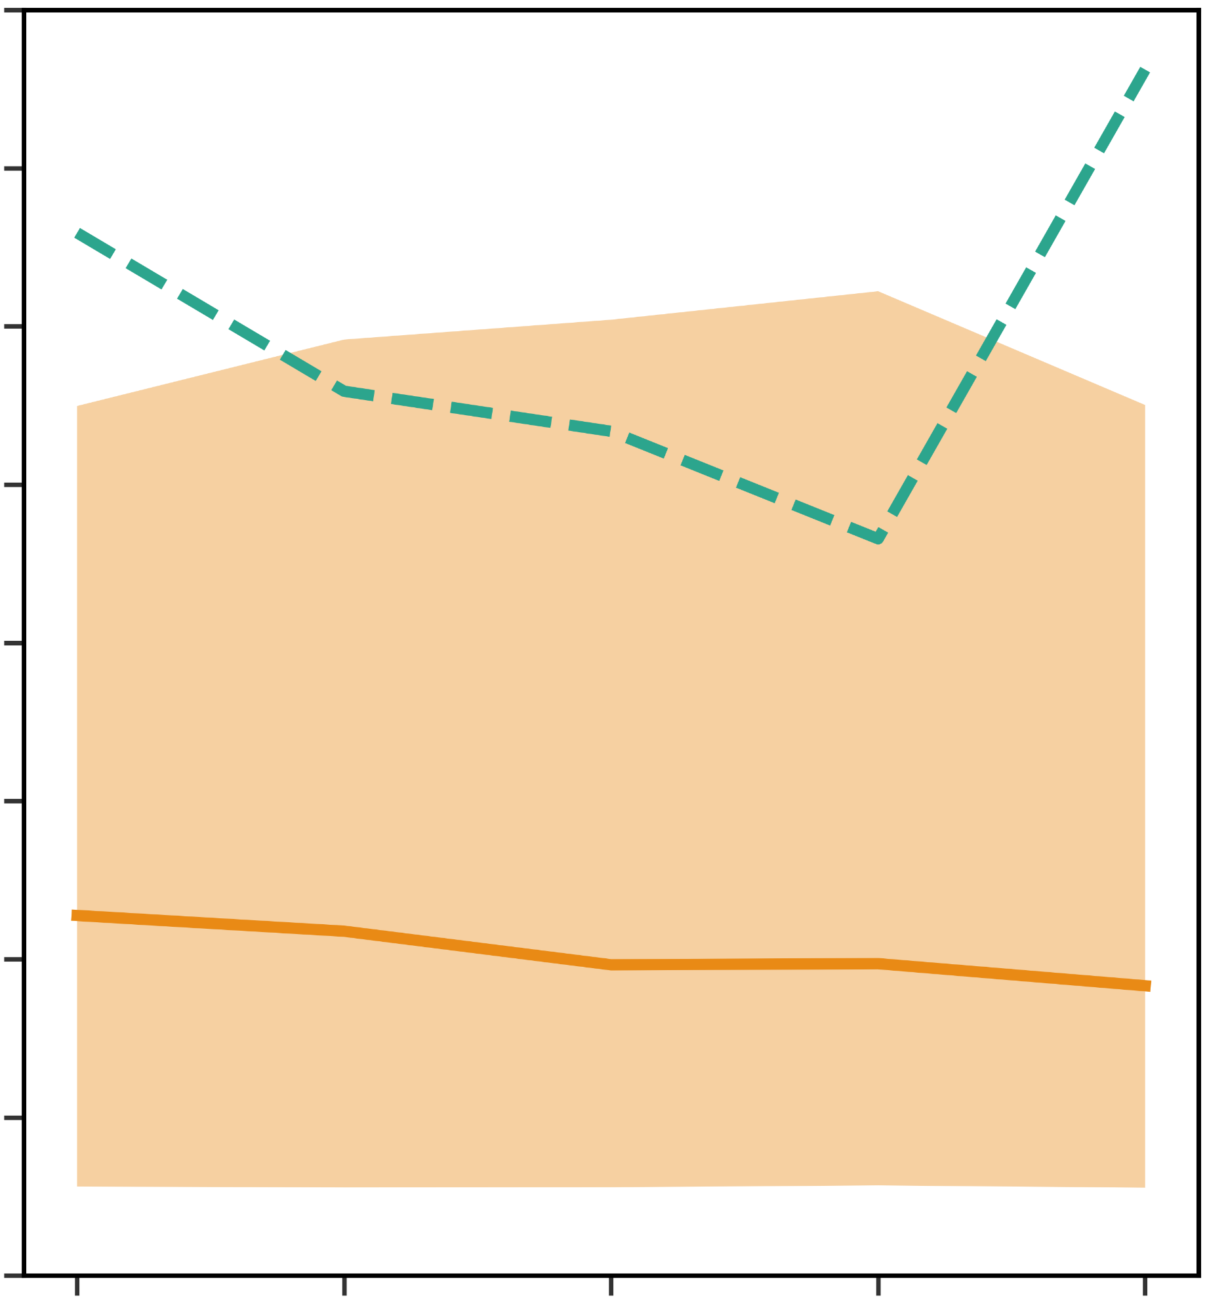
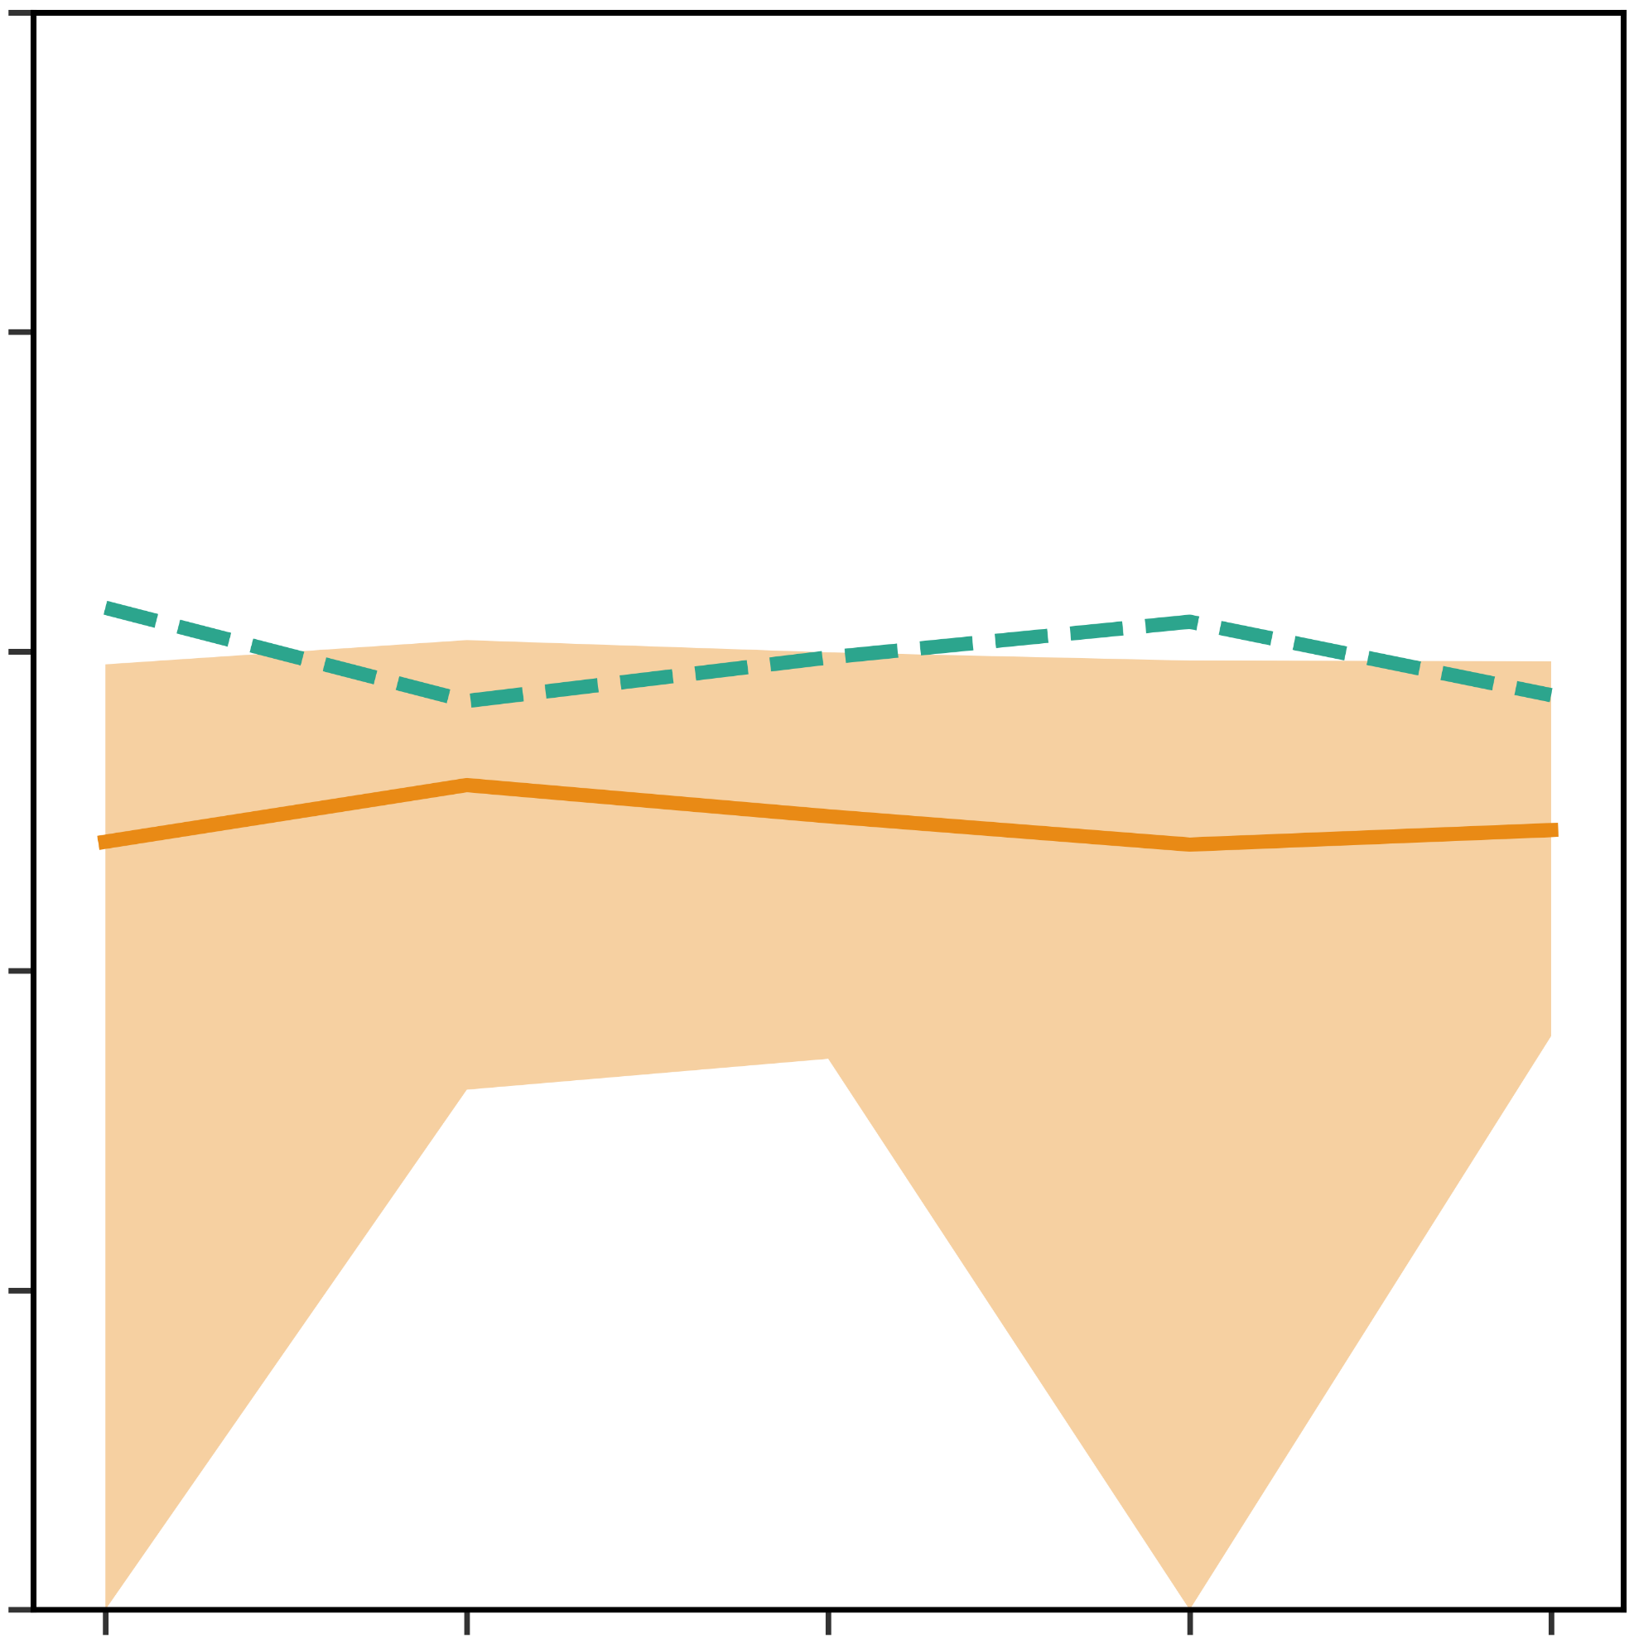
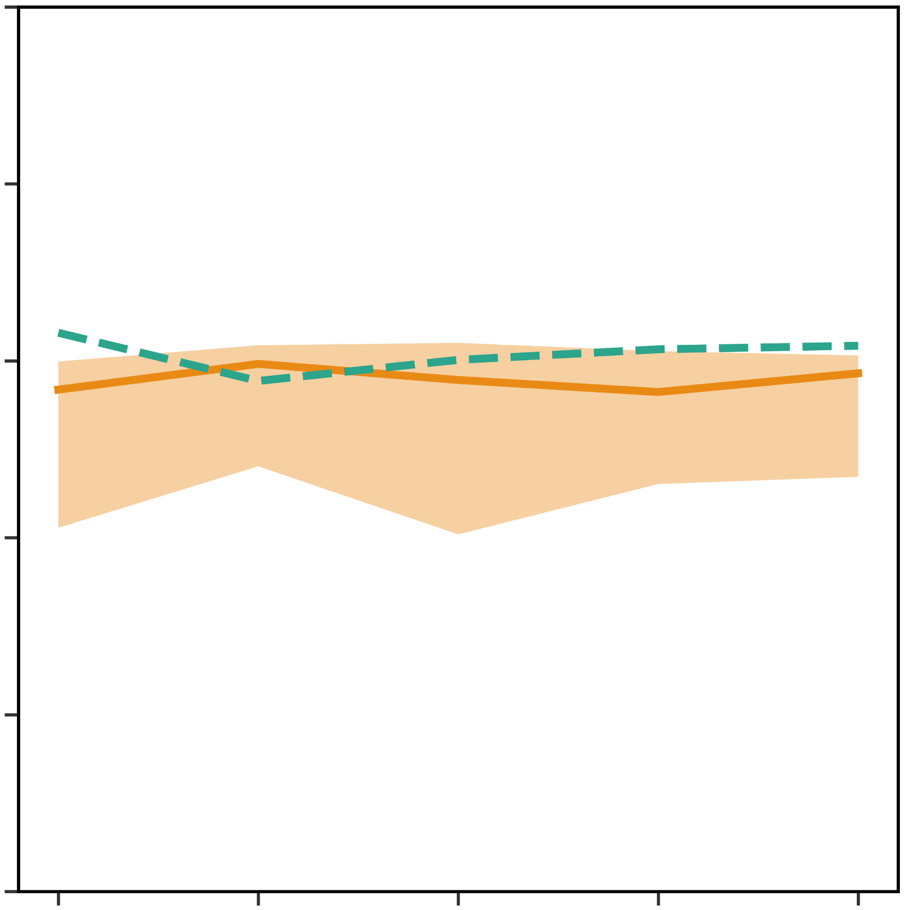
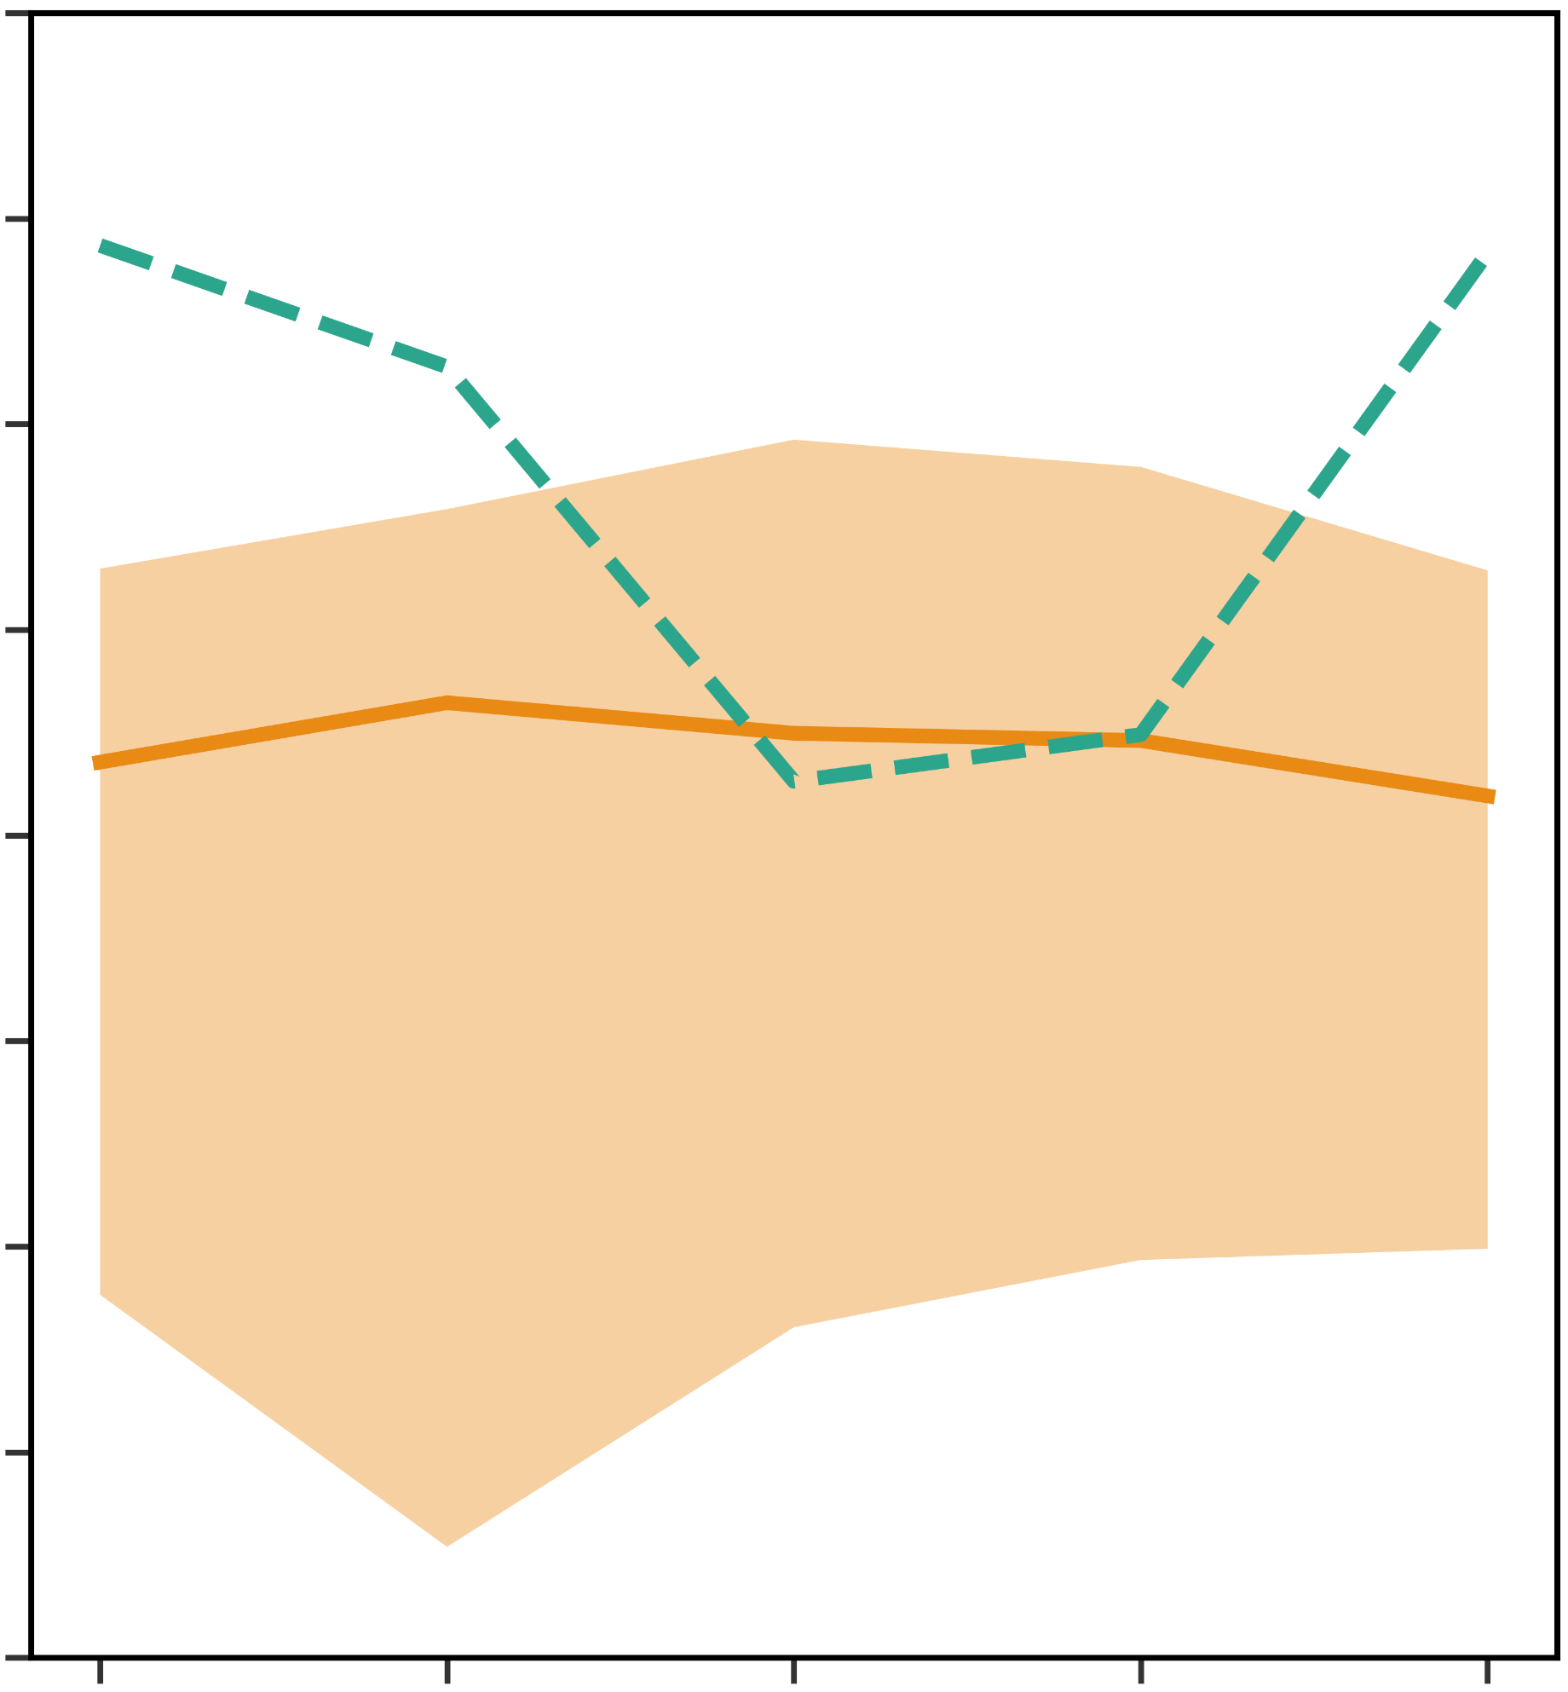
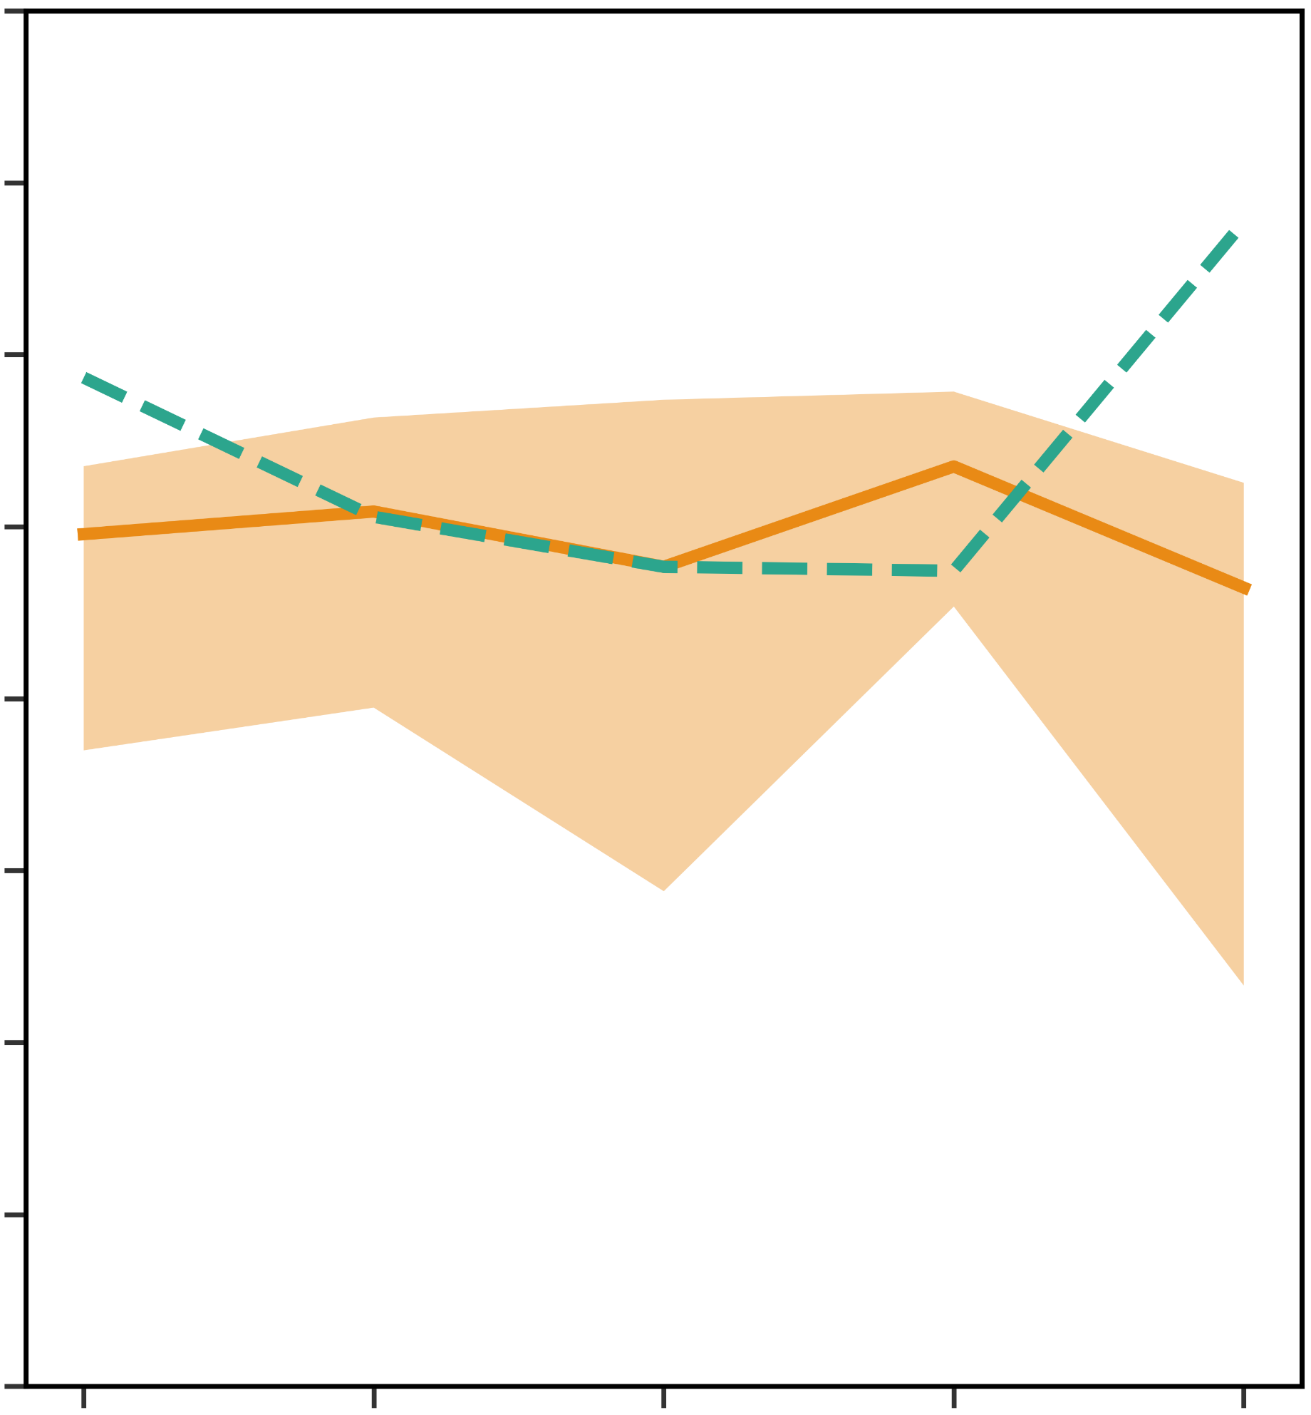
Optuna Hyperparameter tuning and model generalisation
Evaluation metrics over inner validation and outer fold test datasets
AUC-ROC
AUC-PR
Loss Function – Balanced Data
Loss Function – Imbalanced Data
Loss Function – Balanced Data
Loss Function – Imbalanced Data
RANDOM FOREST XGBOOST
1
0.04
0.9
0.03
0.8
0.02
0.7
0.6
0.01
RANDOM FOREST LIGHTGBM
1
0.04
0.9
0.03
0.8
0.02
0.7
0.6
0.01
GRADIENT BOOSTING XGBOOST
1
0.04
0.9
0.03
0.8
0.02
0.7
0.6
0.01
GRADIENT BOOSTING LIGHTGBM
1
0.04
0.9
0.03
0.8
0.02
0.7
0.6
0.01
GRADIENT BOOSTING CATBOOST
1
0.04
0.9
0.03
0.8
0.02
0.7
0.6
0.01
FEED-FORWARD NEURAL NETWORK
1
0.04
0.9
0.03
0.8
0.02
0.7
0.6
0.01
1
2
3
4
5
1
2
3
4
5
1
2
3
4
5
5
Outer Folds
Outer Folds
Outer Folds
1
2
3
4
Outer Folds

